Slide 1
R E M E D Y
Strategic Use of Settlements and Remedies in the Grievance Procedure
By Eric Chornoby, 480-481 Area Local

Slide 2
Sources / References
Practice and Procedure in Labor Arbitration by Owen Fairweather
How to Prepare and Present a Labor Arbitration Case by Charles S. Loughran
How Arbitration Works by Elkouri
Evidence in Arbitration by Marvin Hill
Remedies in Arbitration by Hill and Sinicropi
APWU Arbitrations
NALC Arbitrations
Technical Assistant at Arbitrations
Step 3 Grievances
US Constitution
ELM
CBA
Judiciary Opinions
Hundreds of years of Arbitration precedence

Slide 3
Introduction
Who am I
Why this is important
Why I hate training
We all want money, but money is a result of proving the violation and the harm
Violation
Harm
Remedy

Slide 4
Back to Basics
Understanding the limits of Remedies

Slide 5
Remedy vs Settlement
A Settlement is what the parties involved agree to and sign
A Remedy is, “the means by which the violation of a right is prevented, redressed, or compensated”
As a Steward, you draft a Settlement
The Remedy is the portion of the Settlement that makes all parties whole
The value of a Settlement is based on the strength of the Remedy imposed
You can agree to any Settlement you can talk Management into, but for it to resolve a situation and be a Remedy it must clearly resolve or address the issue and be enforceable

Slide 6
What Prevents Successful Remedies
Most Stewards fail to either prove the violation, or fail to prove the actual harm to the Grievant, Craft, and/or Union
Asking for money is not something you do because you are angry or feel a way
Asking for unsubstantiated remedies can have you lose your case, and often prevents lower level resolution
Asking for the wrong type of remedy
Having no CBA grounds to ask for a specific remedy
Precedent and Previous Language
Arbitrators opinions vary

Slide 7
Arbitration Limits
Arbitrators are bound to the language of our CBA, the mutually agreed interpretation of the JCIM, and the precedent of previous Settlements / MOUs
Arbitrators can impose remedies outside the CBA when the CBA is silent on the acceptable remedy
Arbitrators under normal circumstances will not dissent against an accepted industrial remedy
All remedies must ‘draw it’s essence from the agreement’

Slide 8
Two Elements of a Winning Remedy
Violation
Harm
The specific CBA or ELM language violated
The specific interpretive language or precedent violated (Such as MOU, LMOU, Settlement, Arbitration)
Must prove the violation occurred
The negative impact, financial or otherwise
“loss of or damage to a person's right, property, or physical or mental well-being”
Must identify if it is Employee, Craft, or Union
Must prove the harm exists

Slide 9
Common Scenarios #1
Notice of Removal
Violation:
Article 16, Due Process
Harm:
Loss of Job, Insurance, Retirement and Money
Remedy: Reinstatement, restitution and back pay

Slide 10
Common Scenarios #2
Over 12/60 Hours Worked
Violation:
Article 8, ELM 432.32
Harm:
Harm to Craft / APWU, Time away from Family
Remedy: JCIM 8.5 Additional 50% Premium

Slide 11
What to learn from Examples
Both examples have remedies defined in the JCIM for harm to the individual Grievant
An Arbitrator will never rule outside the confines of this language UNLESS you identify another violation that creates additional harm
Example 1 is open to an arbitrators interpretation – The more you prove the more likely the Grievant is to receive back pay and restitution
Example 2 is straight forward – If X happens, Y is the result
If the JCIM or CBA have a remedy, ask for it explicitly

Slide 12
Where Do We Go Wrong?
The biggest issue I see with Grievances is they either fail to prove the violation or the harm
For every cited article of the Contract you must ‘prove’ the violation and prove the harm
I have seen many Grievances withdrawn or not further appealed at Step 3 because one of the two basic elements were missing
If your Remedy (Or requested settlement) does not match the violation and the harm, you will not win your Grievance
Treat every Grievance as three parts. Prove the harm. Prove the violation. Then prove how your Remedy fixes the harm and violation!

Slide 13
Getting to a Winning Settlement
The Strategy to Better Remedies

Slide 14
The Strategy of a CBA Remedy
A CBA Remedy is a Remedy which is specifically defined in the JCIM or the CBA
Stewards often make a fatal error here. Just because the JCIM has a remedy does not mean you do not need to prove the violation’s harm
Example: If the JCIM allows a make up Overtime day, you still should argue in your Grievance the employee was available/willing to work on the day the violation occurred!
Arbitrators rule on a ‘make whole’ philosophy – No party should be harmed for a ‘mistake’
A CBA Remedy, at a Lower Level, can be used and cited as the premise for a future escalating Remedy

Slide 15
The Strategy of a Non CBA Remedy
Arbitrators often have ‘tied hands’ based on your case file, the CBA, precedent / industry accepted resolutions
To seek a remedy which is not common, or goes against the usual rulings, you must prove violation, prove harm, identify the victim, and have the proper set up to prove the normal remedy does not resolve your Grievance
Again, Arbitrators rule on a ‘make whole’ philosophy – No party should be harmed for a ‘mistake’
For a Non – CBA Remedy, you must often rely upon previous Settlements or Precedence to argue the need for an increased Remedy

Slide 16
Existing Language
The most important factor in getting a remedy which expands the Unions / Grievants rights or provided financial compensation is a recurring violation that specifically goes against an existing settlement or language
Without clearly defined parameters, financial remedies are unlikely
Arbitrators nearly universally dislike when a single party enters an agreement and continues to willingly violate – Sadly they cannot enforce unenforceable language
Most language lacks either enforcement or remedy

Slide 17
No Remedy / No Enforcement
No Remedy
No Enforcement
If the language is violated without a remedy, the defense mechanism is to file a Grievance to determine what would be an appropriate Remedy
If no remedy is clear, the parties argue for a ‘make whole’ remedy in which the APWU must prove the harm of the violation
If the language is violated without enforcement, the defense mechanism is to continually file Grievances for enforcement
No party is entitled to additional compensation except enforcement at face value UNLESS the APWU can prove recurrence, excessive harm or willful disregard

Slide 18
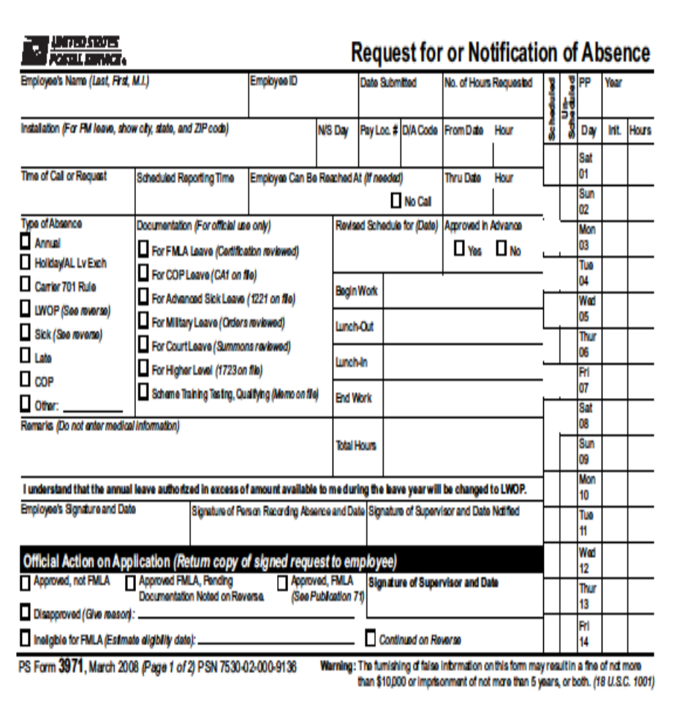
Language Example – 3971s
Royal Oak Bid Cluster LMOU requires a 3971 Submitted to a Supervisor shall be returned within 72 hours, or it shall be granted
The language has a remedy, approval after 72 hours but no explicit enforcement
Traditional Grievance remedy would be enforcement of the language to ‘Make Whole’

Slide 19
The Settlement Ladder - Pretext
Using the 3971 Example, let’s say Management has been violating this agreement left and right
First, you must identify your end goal
Example: Additional penalty, more protections, etc
I would want an automatic enforcement mechanism with a penalty for failing to comply
Why? Reduced grievance activity, continued noncompliance, etc
The question is how do you get to that point? You file class action Grievances regularly seeking your new remedy

Slide 20
The Settlement Ladder – The Steps
Start with the missing element – Enforcement or Remedy
First step is a Class Action Grievance codifying the missing enforcement, or remedy or escalating remedy
Example: “The parties mutually agree that in the event Management does not return the 3971 in a timely manner, pursuant to the LMOU, it shall be approved with the leave type the employee requested”
Second rung is a Cease and Desist
Example: “The parties mutually agree to cease and desist violations of the LMOU and Settlement (Union Number XX-XXX) by improperly handling 3971s. Future violations shall result in compensation to the APWU for processing additional Grievances”
Third rung is a Grievance on failing to comply with the original LMOU language, and the Cease and Desist language

Slide 21
Settlement Ladder
How to actually Win

Slide 22
Why Ladder?
Management is extremely unlikely to give you what you ask when you seek ‘everything’ at once
Arbitrators will not grant an escalating remedy unless the Union can prove ‘recurrence, excessive harm or willful disregard’ Your first Grievance is to establish the violation
Your second Grievance proves recurrence
Your third Grievance establishes willful disregard
If your third Grievance goes to arbitration, and you properly cite all the previous settlements and cases, you have a shot to get an additional financial remedy and/or language

Slide 23
Third Grievance Remedy
Your third Grievance remedy would be similar to, “The parties mutually agree that all parties shall comply with the LMOU and all previous settlements. The Grievants identified in this Grievance shall have the absence changed to approved, using the employees requested leave type. In an effort to resolve this matter, the APWU shall be compensated a one time payment of $150, $50 dollars for each Grievance of the same violation”
The entire goal of the third Grievance is to loop together the separate elements Arbitrators require for additional compensation
Initial Violation -> Cease and Desist - > Violation of Previous Settlements / Recurring Violation
This type of remedy is only applicable because Management violated several previous local settlements

Slide 24
The Words We Use
Why every word matters

Slide 25
The Intent of Your Settlements
Every word, coma and period in your settlement matters
Contractual disputes revolves around the intent of the agreement and the actual wording of the agreement
You may intend your settlement to mean one thing, but if Management disagrees you have a dispute
It is essential that the language in your settlements is void of interpretation or conjecture
Clear, precise language is how you prevent your Settlements backfiring
In Contract Law, the ‘why’ does not matter unless the agreement is ambiguous

Slide 26
Common Settlement Language
Term
Meaning
Explanation/Source
Shall
Must
Will
May
Should
Expunge
Imperative, mandatory but may be negotiable
Obligated to but not negotiable
Obligated to without a timeline
Can occur, usually with stipulation; Permission granting
Recommended to comply
To Remove as if it never occurred
Smith v Spizzirri, Wheeler v. Chicago, People v. Chicago Sanitary Dist
Black’s Law Dictionary
Black’s Law Dictionary
Common Law
Common Law
Black’s Law Dictionary

Slide 27
Common Language Issues
Term
Issue
Shall
Must
Will
May
Should
Expunge
Requirement in 99% of circumstances – Issues normally are based on surrounding language
Concrete, non negotiable language, but prevents Union from alternative interpretations in the future
Allows Management to delay compliance unless a specific timeline in immediate surrounding language – prone to renegotiating
Not easily enforceable unless it is an employee option “employee may use any leave type”
Language is a recommendation, or a best practice – almost impossible to enforce
No issue in isolation, issues exist with surrounding language

Slide 28
What Term Fits Best? (It’s a trick question)
“Management _____ not implement work changes/modifications without prior notification to the 480-481 Area Local of the American Postal Workers Union”
Why? Language prohibits a future action
“Any employee in an overtime status for one (1) hour or more _____ be provided an additional fifteen minute break”
Why? Is not open to interpretation and has no ambiguity
“_____ make every effort”
Why? While this term does not provide much room for interpretation, it allows the Union to challenge Managements effort

Slide 29
What Term Fits Best? Part 2
“Employees not on the Overtime Desired List (OTDL) _____ exempt from Mandatory OT (Overtime) if notification to Management is made no later than 2 hours preceding the scheduled (OT) Overtime”
Why? It is the employees option
“… _____ any dispute arise over the compliance with this award, the Arbitrator shall retain jurisdiction”
Why? Compliance is expect. This only triggers under specific circumstances

Slide 30
Common Settlement Phrases
Term
Meaning
Shall Make Every Effort
Cease and Desist
Shall be removed / expunged from the Grievant’s record as long as/if
Reasonable Effort Shall Be Made to Comply
Firmly Stop and will not resume in the future
The issued discipline will be completely removed from the Grievant’s record, as if it never happened, if terms are met

Slide 31
Common Phrase Issues
Term
Issue
Shall Make Every Effort
Cease and Desist
Shall be removed / expunged from the Grievant’s record
Management is only obligated to reasonably try to comply – forces union to prove they did not do enough
In a vacuum, this language has no enforcement or penalty for non compliance
The preceding language may have stipulations that are undesirable – ensure any stipulations are clearly defined

Slide 32
Choosing Better Words
Take what is enforceable

Slide 33
How to Decide Terminology
If the term must, in most situations, is superior to shall. Why do we use shall?
Shall is far more likely get signed and settled by Management
Shall has precedent in the APWU, and the risk of dispute is extremely low unless you intentionally draft a settlement in a way it can be disputed
Takeaway: We have a contractual obligation to lowest level resolution. As long as your settlement is clear, not subject to misinterpretation and enforceable, the language should be fine

Slide 34
What NOT to Say
Avoid using the phrase ‘Shall make every effort’ UNLESS this is a strategic choice
Explanation: Management may be unwilling to sign a settlement which mandates action, and your case may not be strong enough to win at Arbitration. ‘Every effort’ settlements allow you to gather more evidence at the next violation
Avoid Cease and Desist UNLESS this is a strategic choice, you need language, or the CBA / JCIM has a specific remedy
Explanation: Cease and Desist is either the first step in a Grievance strategy, add on language to another remedy, or a remedy we seek when the violation does not have clear harm

Slide 35
Managements Word Choice
A Good Labor Relations team will ensure the language used is as ambiguous as possible
Until you can easily write and interpret Settlements, NEVER allow Management to write a Settlement for you
Labor Relations does receive instructions on how to settle cases
Example1: Every couple years Management will be informed a cap exists on how much they can pay out in a settlement
Example 2: The NALC has a recurring problem where Labor Relations refuses to sign ‘Cease and Desist’ settlements, and tries to use language such as ‘shall refrain’

Slide 36
Issues with Managements Words
Example one has a few issues, such as:
Against the CBA
Arbitrary in nature
Prevents Grievant from being made whole
Example two also has issues, such as:
Refrain does not have strong legal meaning
Refrain is to abstain from an action, not an outcome
Does not have precedent for escalation such as Cease and Desist
Takeaway: Management often will try to ‘trick’ the Union into believing compliance exists. Write your own settlements to avoid issues

Slide 37
Arbitration Remedies
When “Make Whole” isn’t enough

Slide 38
A Pre-Amble to Awards
After reviewing thousands of awards I have identified 8 common types of awards granted or requested
The terminology is either directly from Arbitration or coined by myself to categorize
Do not get wrapped up on the names, focus on what they are and when to ask for them
Different NBA’s and Arbitrators use terms differently, use the framework to request the appropriate remedy
The Grievance – Arbitration process is not a ‘shoot for the moon’ process. You must prove why you ask for everything!

Slide 39
8 Common Types of Arbitration Remedies
Make Whole
Language Award
Interest Award
Redress Cease and Desist Award
Remedies Not Requested
Punitive Award
Compensatory Award
Union Award

Slide 40
Make Whole Remedy
Make Whole is the most common remedy you will see with Disciplinary Grievances
The basic premise of a Make Whole Remedy is that the employee is returned to the exact status they would have been in if the action did not occur
Make Whole has no ‘additional’ remedy
Remedies already in the JCIM can be considered ‘Make Whole’
The Key to Make Whole is to prove the violation and the basic harm – Recommended for Discipline

Slide 41
Language Remedy
When the parties cannot agree on the language, application or interpretation of the CBA/MOU/LMOU, a Grievance will be filed for clarification
This is more common at Step 4
A Language Remedy is normally the combination of several lower level Grievances that accumulate and are brought to Arbitration
Arbitrators typically issue a Language Remedies at Step 3 if the issue is facility specific such as LMOU or settlement clarification
The Key to a Language Remedy is you are seeking clarification – Not Recommended if you have any harm or are 100% certain what the language should mean in all situations

Slide 42
Interest Award Remedy
ELM 436, specifically ELM 436.7, allows Interest on Arbitration Awards
In the back of the CBA we have a MOU on Interest Awards
Interest should be AUTOMATIC and does not need to be explicitly requested outside of Make Whole, but does need to be negotiated
Arbitrators typically do not grant Interest Remedies as it can be viewed as ‘Undue Enrichment’
Interest is usually granted only if ‘egregious conduct occurred’ on Managements behalf
The Key to an Interest Award Remedy is Management made mistakes so great the employee was improperly harmed, and the Arbitrator requires interest to make whole – Such as a NOR

Slide 43
Redress Cease and Desist Award
Redress means “The receiving satisfaction for an injury sustained”
Cease and Desist means “an order to prohibit starting or continuing a specific action stated in the order”
The technical definition of a Redress Cease and Desist Award is a Cease and Desist with a Remedy for the harm sustained
This Award commonly happens in Arbitration when the Arbitrator issues a Cease and Desist and retains jurisdiction if either party does not comply
The Key to a Redress Cease and Desist is the Arbitrator must have a suspicion one party will not comply or will not do so timely and wishes to impose a penalty for that in the future

Slide 44
Remedies Not Requested
Arbitrators are empowered to issue what they believe is a proper Remedy despite what is requested
Article 15 requires full disclosure, which includes the requested Remedy
A Remedy Not Requested is common when the requested Remedy is improper or not mentioned at a lower level
The Arbitrator does not need to seek input from the APWU when determining the Award, which means if you don’t ask for it you are unlikely to receive the Award
The Key to avoid Remedies Not Requested is to never put the NBA or Arbitrator in a position they don’t know what you want, as the Arbitrator will default to the confines of the CBA

Slide 45
Punitive Award
Punitive means “Relating to punishment; having the character of punishment or penalty ; inflicting punishment or a penalty”
A Punitive Award is typically outside the confines of the CBA and Arbitrators authority
Arbitrator Ryder, “The trauma and embarrassment of the exposed error should be enough”
Circuit Courts have overturned Punitive Awards
The rare circumstance we receive a Punitive Award is repeat non compliance with a Cease and Desist Award
The Key takeaway to a Punitive Award is Arbitrators will almost NEVER grant them. Do not request a Punitive Award unless a proven recurring violation and you can prove other remedy types have failed for the subject of your Grievance. All Awards requested must prove the harm

Slide 46
Compensatory Award
Compensatory is NOT Punitive! Whenever you ask for ‘money’ to resolve an issue it is technically Compensatory
Compensatory Damages are financial compensation awarded to a Grievant who has suffered harm, injury, or other losses due to another party's actions
This is not a Make Whole Remedy but is often the result of the CBA, Past Practice or Industry Standard not having a predetermined Remedy
In practice, this was more common when the JCIM, CBA and Past Practice did not have a Remedy determined such not being granted a Uniform Allowance on time and someone paid out of pocket for a Uniform already OR a non OTDL employee who was forced to work
The Key to a Compensatory Award is the Arbitrator must agree harm exists that could be resolved with a monetary (and quantifiable) remedy, in addition to the CBA is silent on a Remedy

Slide 47
Union Award
A Union Award is an Award that is made to the APWU directly
Several Grievances have resulted in payment to the APWU
Union Awards are normally issued if Management willfully violated or did not comply with the CBA/Previous Settlement or harmed the crafts represented by the APWU but no individual is entitled to compensation
The Key to a Union Award is identifying and proving when Management is willfully violating the Contract, or Previous Settlements. Arbitrators agree that even if an employee is not harmed, a violation of the Contract still requires a Remedy

Slide 48
How to Use Arbitration Remedies
Improve Your Remedies and Grievances

Slide 49
What Good Awards Have in Common
A Good Award has clear language, is enforceable, and ensures all parties are not punished but the harm is corrected
Of the main 8 type of awards Arbitrators see and Unions ask for, the successful remedies follow the basic premise of proving a violation and proving the harm
All additional remedies, outside ‘Make Whole’ as a standard, requires a degree of intent or recurring violation
When you see a Good Award, read the Arbitrators Opinion and the arguments both sides made. Arbitrators can disagree with the Unions reasoning and still find Management guilty

Slide 50
When to Cite Arbitrations
An often ignored fact of the Arbitration process is not all Arbitrators agree with each other and can dislike a ruling from Step 3 / Arbitrations
You want to cite Arbitrations which affirm the industry standard, follows a remedy seen in the CBA, or directly apply to your Grievance
Even if you have a perfect Arbitration, it will not win your case
Many NBAs prefer you do not cite Arbitrations but focus on identifying the violation and proving the harm
The biggest risk of citing Arbitrations is if the Arbitrator interprets it differently, conflicting Arbitration Remedies exist, or the Arbitrator who made the cited award exceeded the CBA

Slide 51
Citing Arbitrations
Cite
Don’t Cite
Any Settlement with Cease and Desist Language
Any Settlement which previously resolved the same issue, at the same facility
Any Step 4 which rules on the exact issue
Any Settlement which interprets the language as you do, but is not clear in the CBA
Ambiguous Settlements
Settlements which can be used against your position (Arbitrator rules in favor of Union, but against Arguments)(Management Does this with Mittenthal Opinion on Unjust Enrichment)
Settlements which seek a Remedy or attained one you cannot justify or prove
Any Settlement which you have not read the counter argument / are unaware of conflicting awards

Slide 52
Using Remedies as a Tactic
The key to using Remedies as a Tactic is to work backwards from the intended Remedy and align the violations to the desired outcome
The core principle to multi Grievance strategies is to separate Grievances into individual violations that have different remedies
The most common tactic would be what is known as an Escalating Remedy. This is not a Remedy type, but is a tactic. Each continuing violation you ask for slightly more. That is all an escalating Remedy is
Example 1: You Settled a Grievance for $500 and Management has not paid it after 2 weeks. The settlement did not have enforcement. You file a Compliance Grievance under Article 15 and ask for an additional 10% of violation amount. If not paid in 2 weeks, you refile, this time for 15% of original amount. You slowly increase the remedy amount

Slide 53
Using Remedies as a Tactic Part 2
Example 2: Same core violation. You Settled a Grievance for $500 and Management has not paid it after 2 weeks. The settlement did not have enforcement. You file a Union Remedy under Article 1 and ask for $100 paid to the Union and 10% of the original remedy. If not paid in 4 weeks, you refile, this time for $200 paid to the Union and 15% of original amount
Every Grievance should have a separate strategy to ‘win’. If Management fails to comply, settle, or pay you should file multiple Grievances for pressure
You want to select the appropriate Remedy type, follow the rules for it, and rewrite a new Grievance to prove the Settlement types violation

Slide 54
Using Remedies as a Tactic Part 3
Three main paths exist for recurring violation / non compliance Grievances. Each establishes a different type of harm
The first Grievance is over Managements harm to the APWU
Union Remedy:
Via Article 1, Maybe 5.
Argument Examples:
Management is intentionally interfering with the Unions ability to organize, maintain membership, and represent its members by not honoring settlements
Management is reduces and weakens the Unions standing with the membership by not complying with Settlement
USPS has punitively forced the APWU to expend additional resources to pursue remedies which are unnecessary

Slide 55
Using Remedies as a Tactic Part 4
Your second Grievance would be for Managements failure to comply with the Previous Settlement
Compensatory Remedy:
Via Article 15
Argument Examples:
Management is required via Article 15.4 to promote lowest level resolution, and failing to comply makes this improbable if not impossible
Article 15 requires that Arbitrations are final and binding
Article 15 mandates that Managements designee has the authority to settle, and non compliance indicates they did not have such authority

Slide 56
Using Remedies as a Tactic Part 5
The third Grievance is a Hostile Work Environment due to Management creating unrest on the workroom floor
Compensatory Remedy
Via Article 14, 15, 19. Possibly Article 1, 5
Argument Examples:
Management is intentionally creating distrust, unrest and hostility via noncompliance required by Article 15 between APWU Members and Management which violates 14 and 19 (ELM)
Management is pitting the Membership against the APWU by making them appear ineffective violating 14 and 19, and potentially 1 and 5

Slide 57
Remedies as a Tactic
Once you understand how Arbitrators typically settle each Grievance type, you can then use that to your advantage
Stewards are commonly taught to use the multi-Grievance Strategy as some region’s NBA prefer this strategy
You do not need to use multiple Grievances, or a ladder method for your Grievances – but you must prove the Remedy you request is appropriate
If you choose to do one Grievance, you must establish a nexus between each violation and each portion of your requested Remedy

Slide 58
Final Thoughts

Slide 59
Arbitration is Complicated
As Stewards, we often view Arbitration as a powerful tool we can use to win. It is not until you have more experience with Arbitrations that you realize this is not true
Arbitrators are the final enforcement mechanism of our Contract using legal standards
Arbitrators are hired and paid for by both sides and do seek being rehired
Arbitrators may default to a 50/50 win ratio for both sides to ensure rehiring
Arbitrations can cost thousands per case just to hire the Arbitrator

Slide 60
Using this Information
This information can be overwhelming as it condenses principles from thousands of Arbitrations
What you should take from this are five things
Do not rely on an Arbitrator to do ‘what is right’
Do not appeal Grievances you have not proven the violation and the harm
Before sending something important up to Arbitration, try to get a lower settlement which confirms the violation or orders a Cease and Desist
All Settlements you write should be clear, enforceable, and specific
If you do everything right and lose, do not take it personally

Slide 61
More Grievance Help
I have a website I made with custom forms, training books, hard to find USPS books, etc. I personally made it for when I help Stewards from across the Country and so I can access things when I am traveling or at a different computer:
https://apwusteward.com/
Various APWU and USPS forms, training books, and issue specific guidance:
https://www.apwu480.org/forms.php
Jeff Kehlert Training Manuals (Basis for West Virginia Training):
https://www.21cpw.com/?s=Book+Strategy+Series

