Slide 1
Roberts Rules of Order
By Eric Chornoby
MPWU & 480-481 Area Local

Slide 2
ABOUT THE INSTRUCTOR
APWU Experience and Credentials
Background in Meetings
Parliamentarian
General Membership Meetings
Executive Board Meetings

Slide 3
PURPOSE OF PARLIMINTARY PROCEDURE
Problem: Minority is Silenced
Problem: Meetings Lack Structure
Problem: Loudest Mouth Wins
Introduce: Henry Martyn Robert
Why Roberts Rules of Order?
Notes:
In 1863 Henry Robert was to hold a meeting in a church about the cities defense during the Civil War. He expected people to be orderly, well behaved, and to be reasonable. He was wrong on all accounts. He decided to create what we now know as Roberts Rules of Order to fix this. Other parliamentary procedures exist but none have ‘caught on’ like Roberts. The reason is Robert was an engineer. He ranked motions, he had a clear structure, and his system was learnable.

Slide 4
HOW STRICT IS RONR (Robert's Rules of Order Newly Revised)?
The entire point of RONR is to let EVERYONE be heard
Robert believed (And RONR is designed) to be less formal in small groups, and more formal in large groups
Example: Executive Board Meetings (12 or less) usually do not require seconds or introductions, but still require recognition of the chair
In every organization, RONR is adhered to as much as necessary to facilitate a meeting

Slide 5
THE LANGUAGE OF RONR
BODY: The Group / Membership / Attendees.
MOTION: Proposal or topic being brought for discussion to the body. is a formal proposal by a member of the group. Example, “I move that have a Christmas Party.”
SECOND: Giving support to the Motion or support to discuss the Motion. Example: “Second.”
AMENDMENT: Change the Motion. Example: “I move to Amend the Motion by adding …” You can add, remove, and rearrange words.
QUORUM: The minimum allowed number of members required to hold a meeting. NOTE: REFER to Local Constitution for your required Quorum. A Quorum can be required for Officers and Attendees / Members.
QUESTION: To end debate and move to a vote.
CHAIRPERSON: Who runs the meeting. NOTE: Chairperson cannot debate, vote or introduce Motions in most circumstances.

Slide 6
CHAIRPERSON – NOT KING
Before we dive into the technical steps, we need to lay out some facts…
The Chairperson is NOT a KING
While you can use RONR to manipulate meetings, it is not the intent
RONR is NOT designed for virtual or zoom meetings (This is directly in the Q and A of RONR online – while the 12th edition has virtual rules it is DISCOURAGED)
RONR is a way to force the Chairperson and organization to be HONEST and TRANSPARENT – But you MUST know the rules

Slide 7
PREMEETING - AGENDA
AGENDA PURPOSE
STANDARD ORDER OF BUSINESS
Before you have a Meeting you need an Agenda – Or order of events
Your body should follow the order unless a motion is made to change the order of events
A Motion is always in order, but, it is advised to wait until the appropriate section in most circumstances
CALL TO ORDER
ROLL CALL
READING AND APPROVAL OF MINUTES
REPORTS OF OFFICERS
REPORTS OF COMMITTEES
UNFINISHED BUSINESS (IF ANY)
NEW BUSINESS
ADJOURNMENT

Slide 8
MEETING STAGES
CALL TO ORDER – To officially begin the meeting and verify Quorum.
ROLL CALL – Attendance for Officers.
READING AND APPROVAL OF MINUTES – Accepting the Minutes from previous meeting, Executive Board, Treasurer Report, etc.
REPORTS OF OFFICERS – Officers report on their business / what they are doing.
REPORTS OF COMMITTEES – Committees report to the Membership.
UNFINISHED BUSINESS (IF ANY) – Previous Business not decided upon at previous Meeting.
NEW BUSINESS – Any new Business such as Motions.
ADJOURNMENT – To end the Meeting.

Slide 9
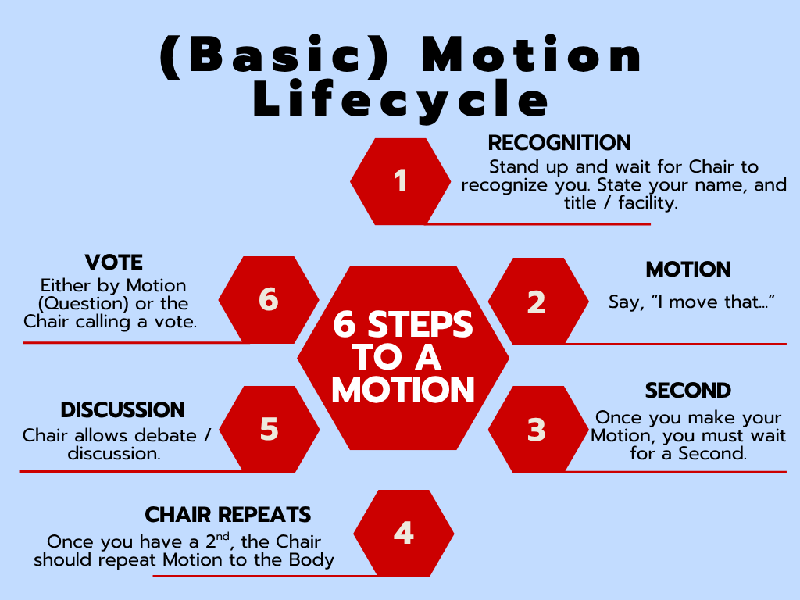
Making a Motion
Your basic motion will follow the structure appearing on the right.
RONR has exceptions to every rule, but, this is what you will see most often.

Slide 10
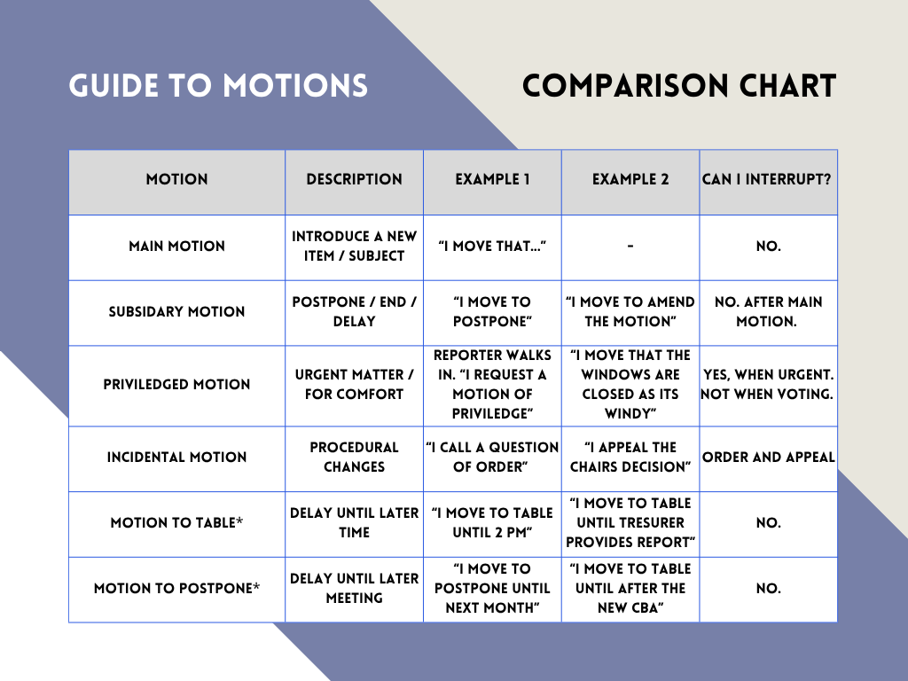

Slide 11
That’s a LOT of Motions…
For the sake of being accurate I included all Main Motion types, but it is NOT needed.
Even the best Parliamentarians keep a copy of Robert’s Rules of Order with them.
99% of Organizations use Motions wrong. It is allowed as long as it does not change the intent of the parties.
Even at National APWU Conventions, HOA Meetings, and in Congress Motions are used incorrectly.
When in doubt, remember you raise a Motion with, “I move that …”

Slide 12
SECRET WEAPON
99.9% of People DON’T KNOW you can make a Fill – In – the – Blank Motion
Member A makes the following motion: “I move that we buy 12 _______ Pizza’s for the next meeting.”
Members B, C, and D submit options during discussion: Cheese, Peperoni, and 6 of Each. The motion in general and the suggested colors are discussed.
A vote is taken on all three options. The choices can be placed on a ballot, or the Chair can take a vote on each choice individually:
“All those in favor of filling the blank with Cheese, say, ‘aye.’ All those opposed, say, ‘no.’”
“All those in favor of filling the blank with Peperoni, say, ‘aye.’ All those opposed, say, ‘no.’”
“All those in favor of filling the blank with 6 of Each, say, ‘aye.’ All those opposed, say, ‘no.’”
The choice that receives the highest majority fills the blank.
The group discusses and votes on the final wording of the motion with the blank filled.

Slide 13
CAN WE DEBATE? YES
Main Motions: Any main proposal is debatable.
Amendments: An amendment to a pending motion is debatable, with the debate focused on the merits of the amendment itself.
Postpone to a Certain Time: This motion is debatable and allows the body to defer debate until a specific time.
Reconsider: A motion to reconsider can be made to bring a previously defeated motion back for further discussion, and it is debatable.
Rescind: A motion to nullify a previous action is debatable.
Refer to a Committee: Moving to send a motion to a committee for further study or investigation is debatable.

Slide 14
CAN WE DEBATE? NO
Table: A motion to "lay on the table" (without a specified time to take it up again) is not debatable and is used to stop debate on a motion.
Adjourn: The motion to end the meeting is not debatable.
Recess: A motion to take a break is not debatable.
Point of Order: Any member can raise a point of order at any time. It is not debatable.
Call for the Orders of the Day: A demand to return to the agenda is not debatable.

Slide 15
DEBATE FAQ
How many times can I speak? A member can speak twice on a Motion on the floor.
Can I speak on my own Motion? Yes, the Motion Maker can speak first and then two additional times.
Can I give someone else my time? Yes, you can ‘yield’ or ‘defer’ your time to another person.
Who is allowed to speak? Each side has an equal opportunity to speak. The Chair should alternate between ‘for’ and ‘against’ the Motion.
When can I speak a 2nd time? You are allowed to speak a second time after everyone spoke once who wishes too.
How long can I speak? RONR allows 10 minutes unless the body votes otherwise.

Slide 16
AMENDMENTS
You raise an Amendment by saying, “I move that we amend the motion by doing … (Add word, remove word, or strike language)”
You can Amend a Motion twice – Example: Main Motion: ‘I move we send people to the All Craft Conference.’ Amendment 1: ‘I move we send 10 people to the All Craft Conference.’ Amendment 2: ‘I move we send 10 people to the All Craft Conference covering Per Diem, Flights and Hotel.’
‘Friendly Amendments’ do NOT exist.
must vote on BOTH the Amendment and the Main Motion.
Amendments DO require a Second.

Slide 17
CAN I INTERRUPT?
You can interrupt in the follow situations:
To get information about what is being discussed: Point of Information
To get information or clarity on rules: Parliamentary Inquiry
If you can’t hear speaker, have safety reasons, have comfort concerns: Question of Privilege
If you see a violation of the Rules: Point of Order
If you disagree with the Chairpersons Ruling: Appeal
If you disagree with Chair’s call for Unanimous Consent: Object

Slide 18
VOTING TYPES
By Voice - The Chairman asks those in favor to say, "aye", those opposed to say "no". Any member may move for a exact count.
By Roll Call -Each member answers "yes" or "no" as his name is called. This method is used when a record of each person's vote is required.
By General Consent -When a motion is not likely to be opposed, the Chairman says, "if there is no objection ..." Unless the body objects, this motion will be passed, however if one member says, "I object," the item must be put to a vote.
By Division - This is a slight verification of a voice vote. It does not require a count unless the chairman so desires. Members raise their hands or stand.
By Ballot - Members write their vote on a slip of paper, this method is used when secrecy is desired.

Slide 19
VOTING PERCENTAGES
Most Motions require a simple Majority (50% plus 1) to pass; except:
To close, limit or extend debate
To suspend the rules
To amend the constitution and bylaws
To close nominations
To remove an officer or expel a member
To object to the consideration of a motion

Slide 20
I WANT TO … PART ONE
Bring a new idea to the Floor: After recognition by the president of the board, present your motion. A second is required for the motion to go to the floor for discussion, or consideration.
You want to change some of the wording in a motion under discussion: After recognition by the president of the board, move to amend by: Adding words, Striking words or Striking and inserting words.
You like the idea of a motion being discussed, but you need to reword it beyond simple word changes: Move to substitute your motion for the original motion. If it is seconded, discussion will continue on both motions and eventually the body will vote on which motion they prefer.
You want more study and/or investigation given to the idea being discussed: Move to refer to a committee. Try to be specific as to the charge to the committee.
You want more time personally to study the proposal being discussed: Move to postpone to a definite time or date.

Slide 21
I WANT TO … PART TWO
You are tired of the current discussion: Move to limit debate to a set period of time or to a set number of speakers. Requires a 2/3rds vote.
You have heard enough discussion: Move to close the debate. Also referred to as calling the question. This cuts off discussion and brings the assembly to a vote on the pending question only. Requires a 2/3rds vote.
You want to postpone a motion until some later time: Move to table the motion. The motion may be taken from the table after 1 item of business has been conducted. If the motion is not taken from the table by the end of the next meeting, it is dead. To kill a motion at the time it is tabled requires a 2/3rds vote. A majority is required to table a motion without killing it.
You believe the discussion has drifted away from the agenda and want to bring it back: “Call for orders of the day.” You want to take a short break. Move to recess for a set period of time.
You want to end the meeting: Move to adjourn.

Slide 22
I WANT TO … PART THREE
You are confused about a procedure being used and want clarification: Without recognition, call for "Point of Information" or "Point of Parliamentary Inquiry." The president of the board will ask you to state your question and will attempt to clarify the situation.
You have changed your mind about something that was voted on earlier in the meeting for which you were on the winning side: Move to reconsider. If the majority agrees, the motion comes back on the floor as though the vote had not occurred.
You want to change an action voted on at an earlier meeting: Move to rescind. If previous written notice is given, a simple majority is required. If no notice is given, a 2/3rds vote is required.
You are unsure the president of the board announced the results of a vote correctly: Without being recognized, call for a “division of the house." A roll call vote will then be taken.

Slide 23
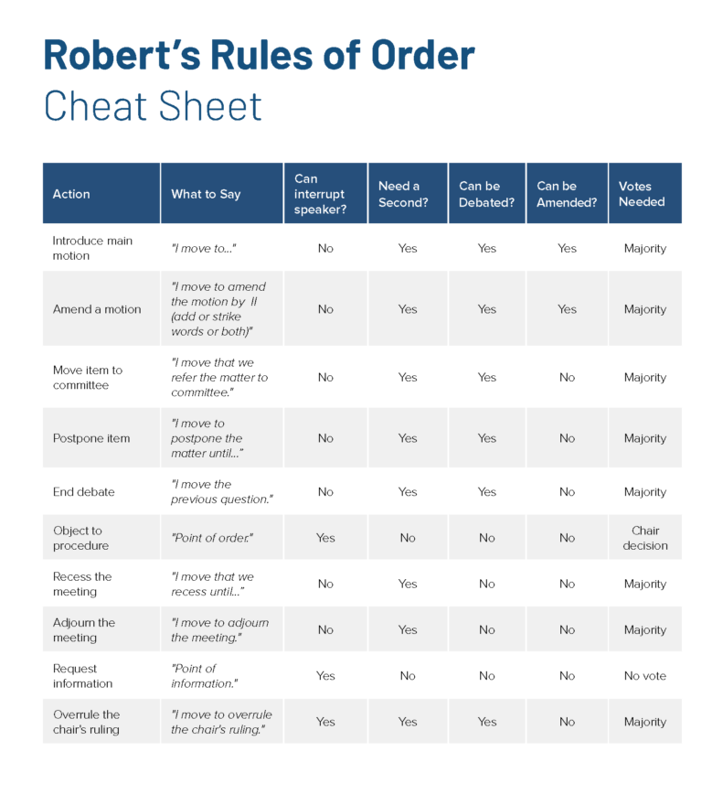
CHEAT SHEET PART ONE

Slide 24
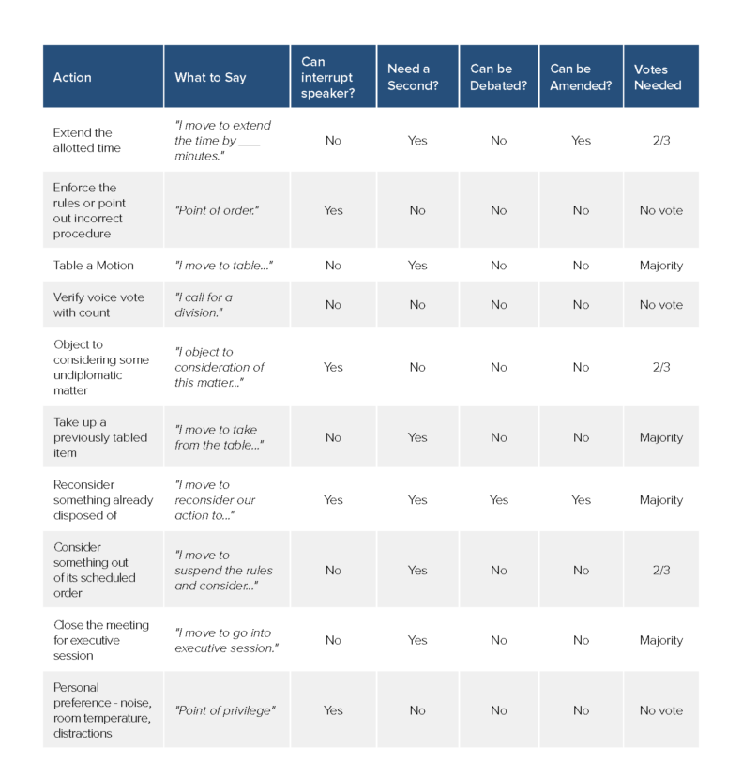
CHEAT SHEET PART ONE

Slide 25
SMALL COMMITTEES
Small Committees would be any Committee with 12 or Less Members
Must you adopt reports? No.
Must each member report? No.
Do I need to get a Second? No.
Do I have a time limit? No.
Can the Chair vote? Vote.

Slide 26
TIPS & TRICKS
Table or Postpone without an end date / time = To Kill.
When Making a Motion say, “Once I get a Second I would like to speak” to increase odds of a Second.
You CAN SPLIT a Motion: “I move to divide the question into the following separate parts …”
You can WITHDRAW a Motion, “I request permission to withdraw the motion.”
You can PREVENT Debate / Discussion by saying, “I object to consideration of this motion” before Debate Begins (2/3 Vote)

