Slide 1
SMALL OFFICE
The MPWU Guide to MAL’s & Local Post Offices for State Officers
By Eric Chornoby, Director of Research & Education

Slide 2
Introduction
An Improvement on Old Training
About the Trainer
How to Use this Training (Participate, Ask Question, and Use the Resource!)
Overarching Concepts:
New Information
Mindset in a Small Office
How the MPWU Works
Officer Responsibilities

Slide 3
Training Specifics
This is NOT New, Basic, or Advanced Steward Training!
The specific topics we will cover includes:
24 - 27 MAL LMOU
2 Hours or Less Custodial Work
1260 Reports (Plus Crossing Crafts)
Post 2024 CBA PTF Rules & Travel
Basic Window Clerk Rundown
Fighting & Keeping BU Work
Reality of Working in a Small Installation
Communicating with the MPWU & the MPWU Structure
POStPlan

Slide 4
The 1st Difference
(MPWU vs Your Local)

Slide 5
A Shift in Thinking
In Your Local you have Precedence (Local Settlements, Local Agreements, and Past Practice from active Representation); while in small offices you have little or NOTHING
Many of the most common situations we deal with daily are directly in our LMOU – Or Local Memorandum of Understanding
Before you can go into a Small Office, you need to FORGET what you ‘know’ from your Local + Learn the MAL LMOU!

Slide 6
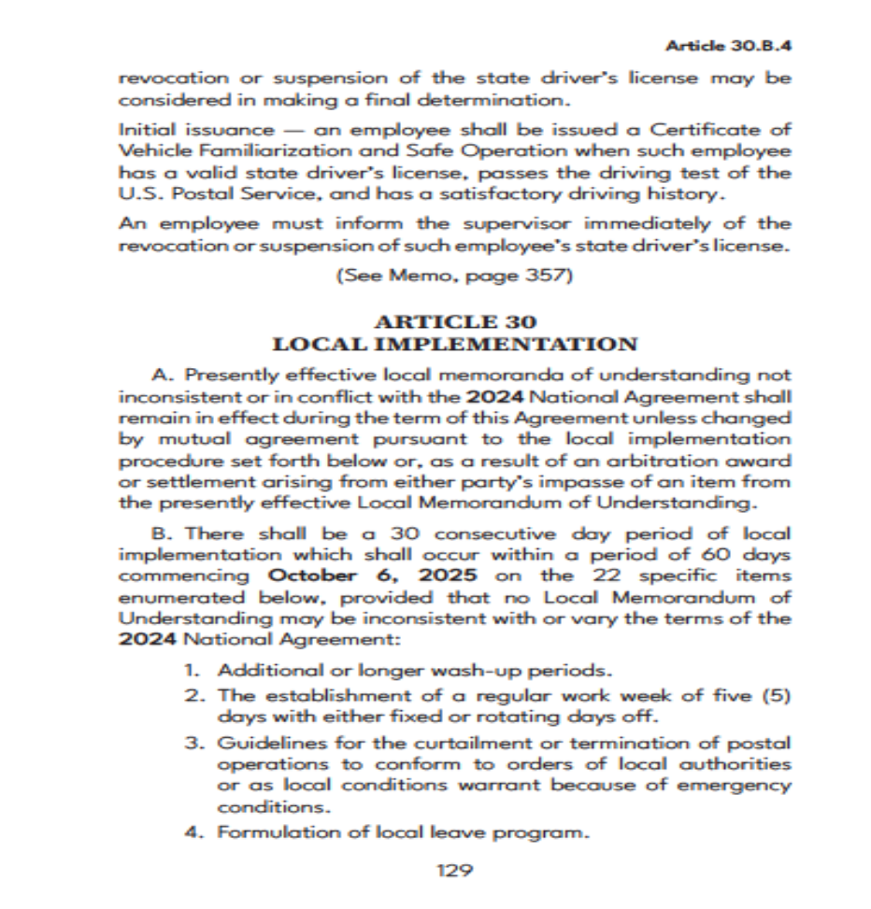
Activity #1 – What is Covered?
Article 30 allows Locals to Negotiate up to 22 Specific Items
These items are “Mandatory Bargain Items” per the NLRB
The MAL (Member at Large) LMOU only covers 12 “Items”
Activity #1 (15 Minutes): I want you to use the provided packet to:
Make a list of all 22 Items covered by Article 30
Make a list of all Items covered in the MAL LMOU
Make a list of what is NOT covered

Slide 7
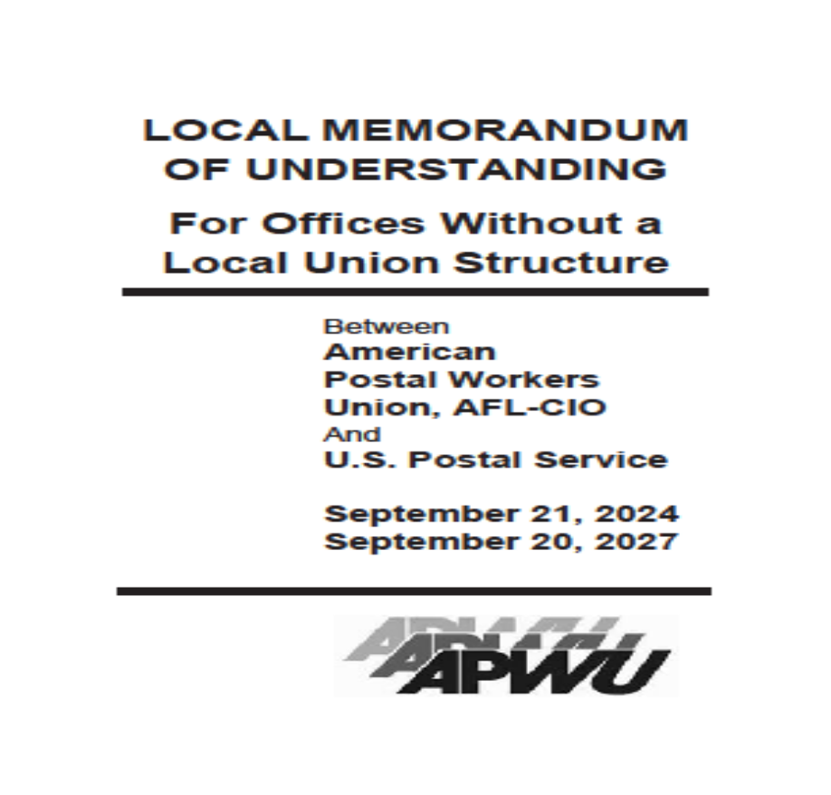
Activity #2 – Your LMOU vs MAL LMOU
Now you should know what can be covered vs what is covered
Next, we want to compare what YOUR LMOU States compared to the MAL LMOU
Activity #2 (15 Minutes): I want you to use your LMOU and the MAL LMOU to:
Highlight the differences in ‘rules’ between the LMOU’s

Slide 8
Exercise #1 - Review – MAL LMOU Opinion
After reviewing the CBA, your LMOU, and the MAL LMOU: Discuss as a group what you noticed about what can be covered, what your Local negotiated, and what the MAL LMOU covers
Consider the following:
Impact to employees
Further Protections
Clarity of the Language
Do you feel the MAL LMOU will make your job representing more difficult or less difficult?
What strengths does the MAL LMOU have?

Slide 9
Small Office
What exactly is a ‘Small Office?’

Slide 10
A Small Office
Before we can continue, we need to break down what exactly a “Small Office” is
For our purposes, a Small Office is any office level 20 & under
In the MPWU we represent MAL’s (Members at Large). These are members who do not fall under a Local Structure

Slide 11
A Small Office Part 2
In Michigan, MALs are Small Offices
A MAL may not be a Small Office, but all in Michigan are
This may change in the future, and it may be different in other states
We will focus on ‘Small Offices’ because those of us from a Local tend to have little to no experience in Small Offices

Slide 12
Large Offices
In the APWU we conduct ‘Small Office’ training at Conventions & Conferences, but that is not the full picture
Normally, a ‘Large Office’ (Above level 20) has enough employees to create their own Local
A Large Office falls under a State Organization when they fail / dissolve
We use the terms Small and Large, but what terms does the USPS use?

Slide 13
Office Types
Throughout the years the USPS has called different offices different names
In general, any Office with its own title Postmaster is called a “Post Office”; “Main Post Office” or “Local Post Office”
Under a Post Office, Main Post Office or Local Post Office (LPO) you have either:
Station -> Subordinate Office in same municipality as Main LPO
Branch -> Subordinate Office outside municipality as Main LPO

Slide 14
Office Types Part 2
Since the 1960’s, the USPS has begun naming things “Units” which is a General term denoting station, branch, or Community Post Office — postal facilities subordinate to a Post Office
You also have CPOs or Community Post Offices, which are contract units in small communities where a LPO no longer operates
Prior to 1973, CPOs were called Rural Stations and Rural Branches
Why does this matter? The Post Office has NOT updated the titles of ALL Offices!
But Eric, what about ‘X’ Office?

Slide 15
Office Types Part 3
The USPS is also inconsistent – some offices have multiple names
The USPS also has created new Office Types due to Arbitration, Negotiation & Legislation
You may also have:
Associate Office (AO) – A Unit
Associate Post Office (APO) – A Unit

Slide 16
Office Types Part 4
Remotely Managed Post Office (RMPO) – A Smaller Office with No Postmaster open 2, 4 or 6 hours
Part Time Post Office (PTPO) – 6 Hour Office with a Postmaster but no large Office / Local Post Office nearby
Contract Postal Unit (CPU) – A CPO located in a 3rd Party facility but reports to a Postmaster / LPO
Village Post Office (VPO) – A CPO with bare minimum service (Such as Stamps only)

Slide 17
Office Type Summary
Why does this matter?
You may represent an Office with an old name and need to determine what Contract language applies to that Office!
Why do you think the USPS has so many different names?
Expansion & Legislation explains many of these differences, but the rest are due to POStPlan!

Slide 18
POStPlan
(Post Office Structure Plan)

Slide 19
Pre-POStPlan Timeline
USPS Born
The Great Postal Strike reformed the Post Office into the USPS – Now an entirely Tax Free Agency which became incredibly profitable – the only self funding US Agency.
Bad Management
Management continued to make landmark mistakes (Passing on a Pre – Email electronic letter delivery service / not investing in sky transportation / not believing Parcel Delivery would become so important), but despite this the USPS was still profitable!
Government Cash Cow
Congress ‘Borrowed’ from the USPS, and began seeing the Agency as a potential financial cash cow. Select Politicians and Competitors (Fed Ex, UPS, and Wall Street) began pushing to strip the USPSs profitable divisions and monopolies.
Financial Crisis
After years of Government intervention (Not allowing rate increases, prohibiting investments, borrowing from USPS accounts, etc) and horrible Management (Raising salaries, hiring top EAS positions, etc), global financial crisis put the USPS in a horrible position.
PAEA
A ‘Perfect Storm’ brewed and Anti-USPS factions prevailed in the Government. Although artificial in nature, the USPS was in trouble. The Government decided to strip away at the Public Service and handcuff it for Generations.

Slide 20
What is POStPlan
To understand POStPlan, you need to know where it came from
In 2006 PAEA (Postal Accountability & Enhancement Act) became law
PAEA required Pre-Funding Retirement, Forced Price Caps, and reducing service in Rural America
The USPS had a GREAT IDEA, Close over 3,700 Post Offices!

Slide 21
POStPlan
The APWU (Plus other Unions, Legislators and Organizations) fought against this reduction of office plan
The USPS came up with an alternative, to cut hours at 13,000 Postal Offices
To accomplish this, in 2011, the USPS changed regulations so new ‘Small Office’ types no longer needed a Postmaster, and these Offices could be remotely Managed

Slide 22
POStPlan Part 2
In 2012, POStPlan was in place – and the APWU filed Grievances over POStPlan
By 2014 the APWU prevailed – the total number of offices changed became 11,000 & several new Office Types were created
Level 4 RMPOs would be staffed by the Bargaining Unit – mainly 25 hour PSE’s and some PTF’s
Level 6 RMPOs would be staffed by career employees, mainly NTFTs working less than 40 hours

Slide 23
POStPlan Part 3
Following our 2014 award, we had several additional awards, MOUs and Q&As
The newly modified ‘POStPlan’ saved delivery to rural America and saved countless APWU jobs – but it changed the ‘rules’ for Small Offices
ACTIVITY – On the next slide scan the QR Code

Slide 24
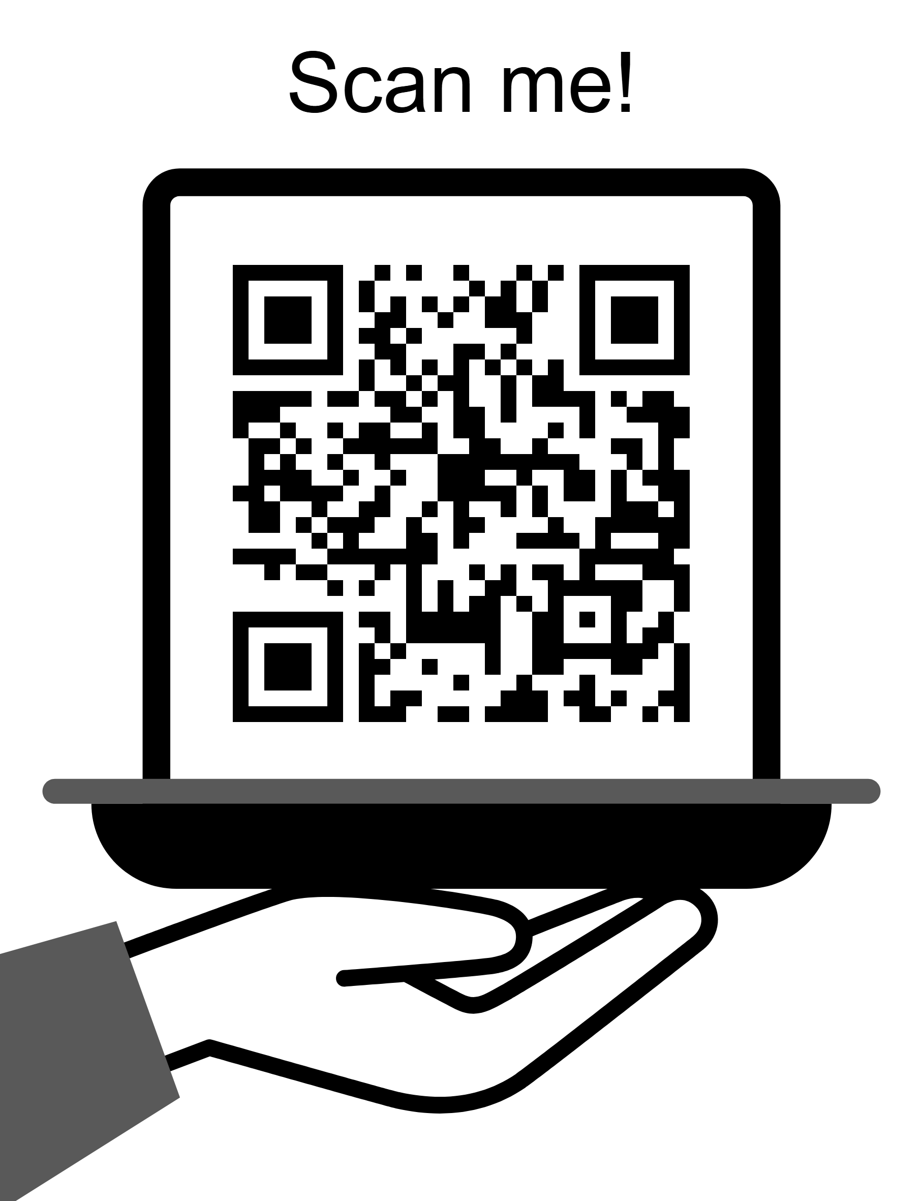
Exercise #1 – Review POStPlan
APWU.org/postplan-explained/
Exercise – As a Group:
Spend 15 Minutes becoming familiar with this page and its content
As a group, discuss (5 Minutes):
What surprises you about POStPlan?
Do you think representing POStPlan is different than a non – POStPlan office?
Ask any questions you have!

Slide 25
Exercise #2 – HOMEWORK
Small Office training presents a problem – it is far too much to cover in a single day and expect anyone to retain the information
POStPlan alone is an 8-hour training
This training is designed to give you the foundation so you can fill in the blanks on your own
Your first ‘Homework’ assignment is to follow every link on the POStPlan link and read the information until it makes sense!

Slide 26
Exercise Help
1 | Youtube Training https://www.youtube.com/watch?v=YVu2xdX_Xpg
2 | Chornoby Flash Drive Many POStPlan Documents are on the provided Flash Drive
3 | The MPWU Structure The Clerk Craft Director, the Director of Research & Education, and the Executive Secretary are ALWAYS available
4 | National Training POStPlan is routinely covered at All Craft & Preconvention Workshops
If you are new, inexperienced, or struggling with reading and understanding Contract Language we do have resources available to help you!

Slide 27
Quick Recap
This would be HORRIBLE training if I did not give you a quick synopsis to get you started…
The most common Grievances related to POStPlan are:
PSE Use / Cap – Provisions exist to exclude PSEs in many of these modified offices from district caps, but strict limits exist. I recommend you check the assigned function of PSE (Window vs Distribution) when you deal with an office to ensure proper compliance
Custodial Work – In the absence of enough hours for a Custodian, Clerk perform this work. We will touch on the MOU’s, but, this work should be on OT or not between customers!
PTF Use – PTF may be working over their hours or being forced to travel (or using their own vehicle). MOU’s will be provided!
Postmaster Relief Use – PMRs have strict limits, and also are not allowed in all Office types. Check the Office level and if they are allowed
1.6 Violation – We will cover this in the next section!

Slide 28
The 1260a Report
Tracking EAS Hours

Slide 29
The 1260a Report
What do you think a 1260a Report is?
Activity from Reading Contract Language Training:
What is a PS Form 1260?
Answer: Main Time Keeping Entry Form
What does ‘a’ stand for?
If you know what a 1260 is, and know what a report is, ‘a’ can only mean a few things
In this case, ‘a’ means Automated
The 1260a Report is the result of a 12-5-2014 Settlement designed to track work Management performs in Small Offices
ACTIVITY – Review the Next Slide / Provided 1260a for 5 Minutes!

Slide 30
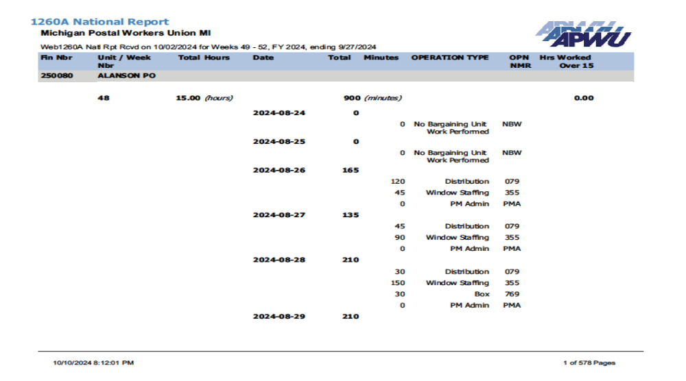
Activity: Review 1260a

Slide 31
Using the 1260a
Approximately every month (4 weeks) the President will send you the full 1260a for all MPWU Offices
You must search for all Offices in your Area and review their information
If Management worked more than the allowed hours, you submit the 1260a violation form on APWU.Org!
The report is the ‘Master list’ but the ‘Violation’ report on your Flash Drive / Provided will also be sent and contains ONLY the violations!

Slide 32
Problems with the 1260a
Why do you think the APWU wanted the 1260a?
The biggest problem is the 1260a relied on Management accurately recording / reporting their hours!
In a Small Office we struggle with member involvement and Steward availability so we MUST rely on the 1260a
Management can falsify the 1260a, but you would be surprised how often Management reports their own violations

Slide 33
1260a Violation = 1.6 Violation
The 1260a is simply an additional piece of evidence that unquestionably proves a violation of 1.6
It also can be a violation of various MOUs, Q&As, etc that we will cover
While Small Office issues cite different language, ALL Grievances are essentially the same UNLESS you it goes to the ADRP Process
If you encounter an issue that should be referred to the ADRP (Per MOU or CBA) you MUST Contact the Craft Director and President!

Slide 34
Exercise Prep
(A Brief Primer on Language)

Slide 35

Fast Thinking
In the next section you will have a rapid-fire mock research situation that you will commonly find yourself in when dealing with members until you memorize Small Office language
Since Small Office issues can be complicated, you need to learn to quickly understand Contract Language AND develop the ability to skim properly to identify what provisions apply

Slide 36
Tools You Have
Previously you were referred to the Youtube video on Reading Contract Language which is an excellent 2-Hour course I STRONGLY recommend
If you get stuck understanding language you should refer to the following Dictionaries to get started:
Blacks Law Dictionary (8th Edition is on the Chornoby Flash Drive) for Legal Terms
The Law Dictionary ( https://thelawdictionary.org/ )
Merriam – Webster Dictionary ( https://www.merriam-webster.com/ )
The Cambridge Dictionary ( https://dictionary.cambridge.org/us/ )
If you still cannot decipher CBA / MOU Language, reach out to your Craft Director or the President

Slide 37
What About …
But Eric, you always reference Arbitrations, Historic Documents, etc in your other training. What about in Small Offices?
For Small Office issues we do not have 50 years of historic documentation, we have at most 14 years of precedence
The largest issues we had in Small Offices (PSE Usage, PTF Usage, Travel to other offices, Using your own Vehicle, and Custodial Work) were resoled with negotiation, MOUs, and new Contractual Language
The majority of gains in our recent CBAs directly resolve issues we have in Small Offices
You do NOT need to do more extensive research than using the provided resources!

Slide 38
Common Language
(A Jumpstart on Small Offices)

Slide 39
Where to Look
In Small Offices you are more likely to deal with PTF’s, PSE’s, and Hired-Off-The-Street Postmasters / PMRs
This presents unique rules and situations you must be prepared to research and handle
To prepare for this research we will perform another activity
Use the list in the next slide, plus your JCIM & CBA to answer the next series of questions (30 minutes)

Slide 40
MOU Starter Guide
These are all in the CBA (With Associated Page #)
HINT: Use a highlighter, mark pages, and fold corners!
Clerical Work (273)
Article 1.6B (274)
Global Settlement (275)
PSE District Caps (284)
PSE Automatic Conversion (286)
NTFT in Retail Level 20 + Under (289)
NTFT Duty Assignments (289)
Modified Work Week (298)
PTF Court Leave (308)
PSE Annual Leave (313)
PTF Annual Leave (313)
Contract Postal Units (365)
Use of Privately Owned Vehicles (371)
Assignment of PTF Hub Clerks (379)
PTF Preference (380)
Residual Vacancies – Clerk Craft (399)
Custodial Duties in Small Post Offices (418)

Slide 41
Activity #1 – Researching, Citing, and Using Contractual Language
PTFs can now ‘opt’ into offices they want to work in. What is the radius they are allowed to ‘opt’ into?
Where will you find the PTF opt language?
Can Management force you to use your own vehicle to travel to another office?
What Article(s), Q&A(s), or MOU(s) will you find POV (Personal Vehicle) restrictions in? (HINT: It is in MULTIPLE Places)
How many hours can a Postmaster perform Clerk Work? (HINT: Multiple Answers that are Located in Multiple Places!)
When can a Clerk Perform Custodial Duties? If yes, what are the requirements to perform Custodial Duties?

Slide 42
Exercise #1 – Discuss Unique Small Office Topics
You should now recognize you must be prepared to research and study until you have the new and/or unique provisions related to Small Offices memorized
You should also recognize that details matter -> A single variable can change the answer to a members question and if something is a violation or not
STORY – Running for NBA & visiting Flint, MI
Exercise – As a Group we are going to refer to the last six questions we answered and discuss them as a group (15 Minutes). The discussion should be focused on the interaction of those specific, yet different, Contractual terms and how they impact the membership

Slide 43
HOMEWORK #2 – Research Connections
If we covered every nuance, we would be here all month – and we would all quit
The expectation is to learn, and you go and only research when you need too
Part 1 of your homework is to read and familiarize yourself with each MOU from slide “MOU Starter Guide”
Part 2 of your homework is to identify other related language and make a ‘Cheat Sheet’ for Small Offices to include relevant CBA language, relevant JCIM language, relevant MOUs / Q&As, and finally the provided list of MOUs
Why do you think we recommend you focus on learning and studying as you go?

Slide 44
The APWU’s Future
America needs Small Offices

Slide 45
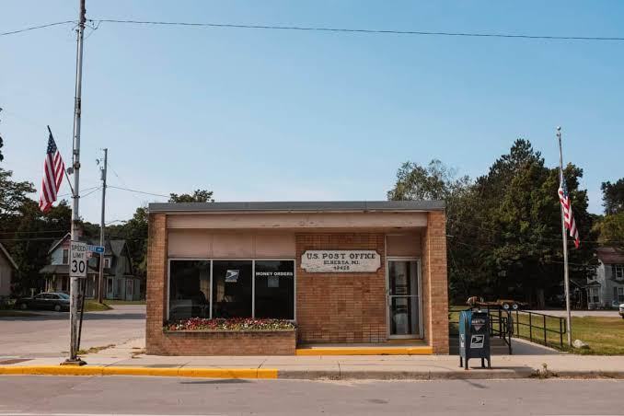
Local Post Offices
Before we explore working in a LPO, we need to dive into the Importance of Clerks in LPOs
Small Offices are the lifeline to America
Small Businesses rely on the USPS
The American Economy relies on the USPS
Clerks in a Small Office directly service the Country, and without them the USPS and Economy would fail

Slide 46
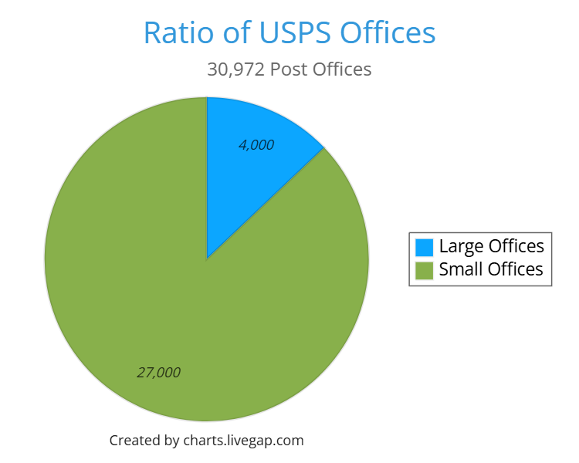
The Bulk of the APWU
According to the Bureau of Labor Statistics there are roughly 73,000 “Clerks”
According to the Bureau of Labor Statistics there are roughly 105,000 “Mail Processers, Sorters and Machine Operators”
The Mail Handler Union Represents roughly 50,000 Employees (Which fall under ‘Sorters’
This means that about 50,000 Clerks work in Mail Processing at “Plants” and the majority of Clerks work in Local Post Offices or other ‘non’ processing facilities!
Following this logic, the BULK of APWU Members are in Local Post Offices

Slide 47
Small Offices are the USPS
Take the last slide with a grain of salt as those numbers are vast generalizations, but the point is simple – more APWU Members work outside ‘plants’ than in a ‘plant’
And the Chart shows us (Based on USPS Report to Congress in 2025) that only 13% of offices are ‘large’ and the rest are ‘Small Offices’.
While we may not represent as many employees per facility, the bulk of Clerks work in, or have worked in, a Small Office
Large Offices (Such as PNDCs) are typically ‘attached’ to a retail unit
The Call Centers are attached to a retail unit / Local Post Office / PNDC
The USPS and Clerk Craft revolves around Small Offices

Slide 48
Future Growth Potential
The potential for the USPS to make more money rests in ‘Service’ which in large part will come from Small Offices
Post Offices sell Passports, Rent PO Boxes, ‘up-sell’ customers, sell postal retail products, sell stamps, etc
When the APWU attempts to get the USPS to offer more public services, it is offered via Local Post Offices
Examples: Postal Banking, Package Return, Public Notaries, etc
Local Post Offices are the lifeline of Rural America, to Small Business, and to the American People

Slide 49
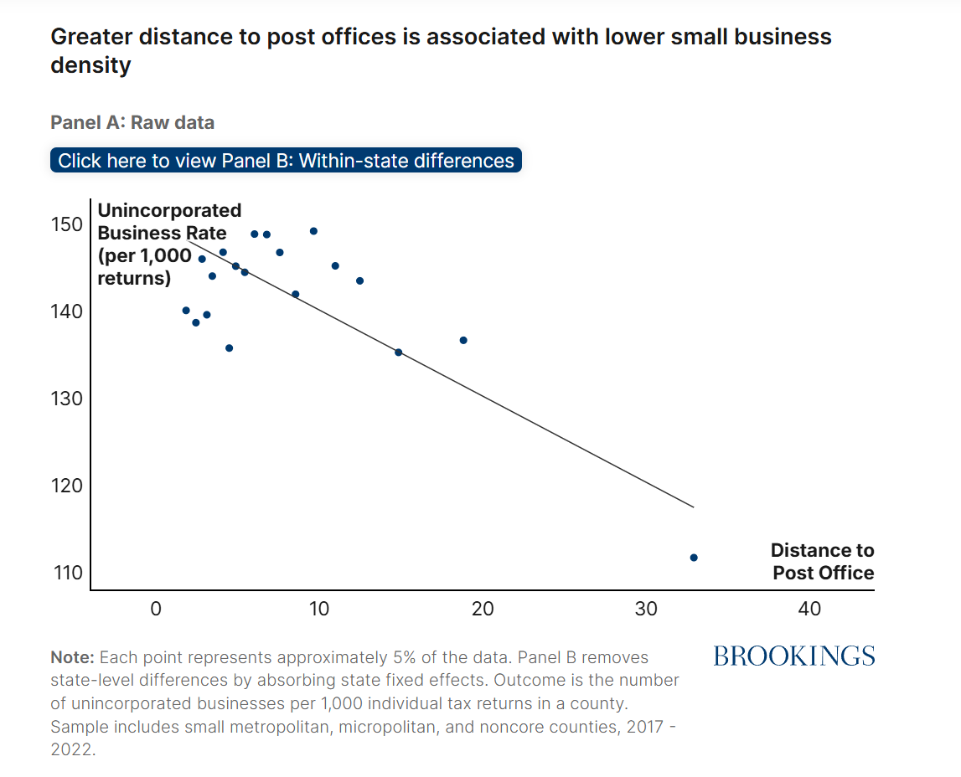

Small Business Needs LPOs

Slide 50
Small Business & the LPO
Clerks in the LPO are the face of the USPS
Clerks assist Small Businesses, connect the Country, sell Money Orders (primary banking in lower income areas), accept Passports, rent PO Boxes (Essential business and rural America function) and so on
According to USAFacts, Small Businesses:
Account for 99.9% of all U.S. Businesses
Drive 44% of U.S. Economic Activity
Create roughly 2/3rds of all net new jobs
Employs roughly 46% of the Private Sector Workforce
America is Driven by Small Business, and Small Business is driven by the USPS

Slide 51
Why does this Matter to YOU?
Clerks at a LPO wear many hats, and as their Union you must recognize the complexity and necessity of the jobs they do
Local Management commonly lets violations slide over issue Discipline as every employee is needed
The mentality in a Local Post Office or Small Office is that of teamwork and family – you know your customer and your Community
As an Area Director you must REPRESENT the employees, which means thinking like them and understanding what they do
In order to deal with Management, you need to understand them, and it is not all numbers – it is about moving the mail, servicing the customers, and in Level 2 / 4 / 6 Offices the Officer in Charge is often from the Community!

Slide 52
Working in a Small Office
Getting to know your Members

Slide 53
What Clerks Do
How many of you work in, or have worked in a Local Post Office / Small Office?
Since the ‘Universal Clerk Push’ in the late 90’s / early 2000’s, we have seen a reduction in specialized bids and an increase in ‘general’ positions
We previously had separate Window Clerks, Distribution Clerks, Po Box Clerks, Scheme Clerks, Timekeeping Clerks, and so on
Now, Management treats a Clerk as a Clerk
Nearly every function except actual delivering Mail is considering Clerk work by the APWU
Just like the Clerks you Represent, you MUST know all operations inside a Small Office better than they or their Postmaster does!

Slide 54
Postal Reality
Clerks in Small Offices wear many hats – which requires you to be an expert in many topics
Being an Area Director is extremely similar to being a Clerk in a Small Office because:
You lack infrastructure
You often must handle issues you have never seen before
You are solely responsible to handle all work / Grievances
Besides what we have covered, what do you think you need to know to effectively represent Members in a Small Office?

Slide 55
Learn to be a Clerk (In a Small Office)
Just like it takes a Clerk years to become an expert, it will take years to be an expert in Small Offices
The first step to learning how to represent members is to learn the role and responsibilities of a Window Clerk
Window Training alone is 40 hours in a classroom in addition to in the field training
The three handbooks or manuals you need to study for retail operations are:
PO-209 Retail Operations Handbook
F-101 Field Accounting Handbook
Sales and Service Associate Training

Slide 56
Other Functions
You will also find yourself dealing with other crafts, other functions and other work
Common examples are: Rural Delivery, City Delivery, Maintenance Craft, MVS Craft, Dispatch, and so on
On the Flash Drive you will have all the handbooks / manuals you may need
I recommend you starting with the following handbooks / manuals
M-22 Dispatch & Routing Policies
M-38 Management of Rural Delivery
M-05 Scheme Training
MS-47 Facility Cleaning

Slide 57
STUDY! STUDY! STUDY!
The theme of this training has been that you will need to put in the work by studying and completing Grievances
When in doubt, you have the Chornoby Flash Drive with just about any resource you could imagine
In addition, the Flash Drive contains a folder specifically for this training
You also have access to the Unofficial Grievance Guide with updates on APWUSteward.com
The expectation is to learn as you go, but what should you do if you have a question, you cannot find the answer to?

Slide 58
MPWU Structure
How to use the MPWU

Slide 59
Defining Roles
The President is ‘in charge’ of all MPWU Operations – the Buck stops with him / her
The Executive Secretary is the Presidents “Right Hand” filling in for the President as needed, greasing the wheels, and handling tasks as needed
Each other Officer has clearly defined roles, EXCEPT Area Director
In other States the Area Director position is called State Business Agent, State VP, and so on
Area Directors are the Unions entire representational authority in Post Offices that fall under the MPWU umbrella

Slide 60
The Area Director
An Area Director may be responsible to file Grievances for ALL APWU Represented Crafts
Area directors must be prepared to answer ANY APWU and USPS related question including OWCP, FMLA, insurance, and so on
An Area Director should be considered the Chief Steward of each MPWU Represented Office in their area
You are exclusively responsible for these Offices unless an emergency happens, a member calls an officer, or you ask for assistance

Slide 61
Member Interaction
Members commonly contact the President with issues – if this happens the President will let you know
You will need to provide members a way to Contact you – most Area Directors provide a personal phone number and email
We recommend you save members in your phone with their Office Location (I.e. Eric Chornoby – Royal Oak) so you know rules specific to them when they contact you
When meeting with Management you normally will meet via phone / email / zoom
What if I need to Travel to an Office?

Slide 62
Lost Time & Travel
All Lost Time must be authorized and approved by the President
All expenses must be authorized and approved by the President
All expense and lost time vouchers must be properly submitted to the Secretary Treasurer in order to be paid
No MPWU Officer is on ‘Union Time’ all day long – if you do not turn your voucher in on time it will be delayed to the following week
‘We ain’t got no money, but we ain’t broke’ – Elizabeth ‘Liz’ Powell
The MPWU has ZERO issue compensating for representation, but the MPWU requires you maximize the opportunity and be fiscally responsible

Slide 63
Office Visit Tips
In a Small Office, you are the ONLY APWU representative the employees will likely ever see – you must act accordingly!
Bring 1187’s and Organizing Materials to leave at the Office
Speak to ALL bargaining unit employees, and as many EAS as possible
Carriers can be an excellent source for Grievance information, and a good relationship in a Small Office with EAS is VITAL
Share your Contact information with the APWU represented employees & EAS

Slide 64
Building Your Team
You are NOT in this alone!
The MPWU Officers are here to back you up
Whenever I contact the President, the Executive Secretary, the Secretary Treasurer or Director of Research & Education they ALWAYS follow up – even if it takes a day
Despite the support you have, you will need to build your OWN team
You should AWLAYS be looking for new members and new Stewards in the Offices you Represent
If you find a potential Steward, contact the President to evaluate and decide

Slide 65
Wrap Up
Representing the Membership

Slide 66
Getting Started
The MPWU has always been a family – while we don’t always see eye to eye, we always have each others backs
You will go long periods of time without hearing from members – that is a good thing!
I strongly recommend you write for the MPWU Paper, the Michigan Messenger – it is the best way to reach all members you represent
If you need additional material or resources, contact the President
Your job as a Steward is to enforce the Contract, sometimes that means members will not be happy – that is OKAY

Slide 67
Closing
Being an Officer in the MPWU requires self guided study and research
If you are ever stuck, the entire MPWU structure is more than willing to help
Do NOT interfere with a Local or member of the MPWU
What questions do you have?

