Slide 1
Fundamentals
“An Advanced look at Fundamental Skills”
Created by Eric Chornoby (480-481 Area Local & MPWU)
Instructors: Eric Chornoby, Roscoe Woods, John Diem

Slide 2
introduction
Advanced Training on fundamental Concepts based on the review of our Arbitrations and Step 3’s, plus thousands of Grievances in the 480-481 Computer System
This training is designed assuming you are a Steward actively representing – we are not here to re-teach the same stuff and insult your intelligence! We encourage you to ASK QUESTIONS!
This training was demonstrated to select listeners of the Podcast APW You with Eric Chornoby to ensure Stewards of every experience level can take something from this training
What we cover is not about anyone doing anything right or wrong, this is designed to provide information and exercises to improve the skill level of every Steward!
This is NOT Local Post Office, Call Center, or Metroplex Training – This is designed for EVERYONE!
I am a firm believer that to absorb information, you need to trust the source, which brings me to your instructors…

Slide 3
Instructors
All three primary instructors have represented employees in all office types!
This includes Mail Processing, Customer Care Center, Local Post Offices, plants, level 18 & Below, etc!
Roscoe​
Roscoe is the current Vice President of the 480-481 Area Local & Legislative Director of the MPWU
Previously Roscoe served as an Officer, including President, of the 480-481 Area Local
Roscoe has served on multiple National Level Committees including the Rank-and-File Committee
Roscoe is the long serving Legislative Director for the MPWU
John
John is the current Executive Vice President of the 480-481 Area Local
Previously John served as Maintenance Craft Director of the 480-481 Area Local
Prior to transferring to the Metroplex, John was an Officer in the FMAL, including President
John is an Arbitration Advocate for the Maintenance Craft
Eric​
Eric is the current Director of Research & Education for the MPWU & Editor of the 480-481 Area Local
Previously Eric has served the MPWU in multiple capacities, including Acting President in 2024
Eric is an Arbitration Advocate in the Clerk Craft & Technical Assistant for National Level Support Services
Eric is the host of APW You and founder of APWUSteward.com

Slide 4
Agenda
01 | Grievance Procedure
02 | Grievance Investigation
03 | Step 1 Meetings
04 | Step 2 Appeals
05 | Practice Makes Perfect

Slide 5
GRIEVANCE
PROCEDURE
01
SECTION 01

Slide 6
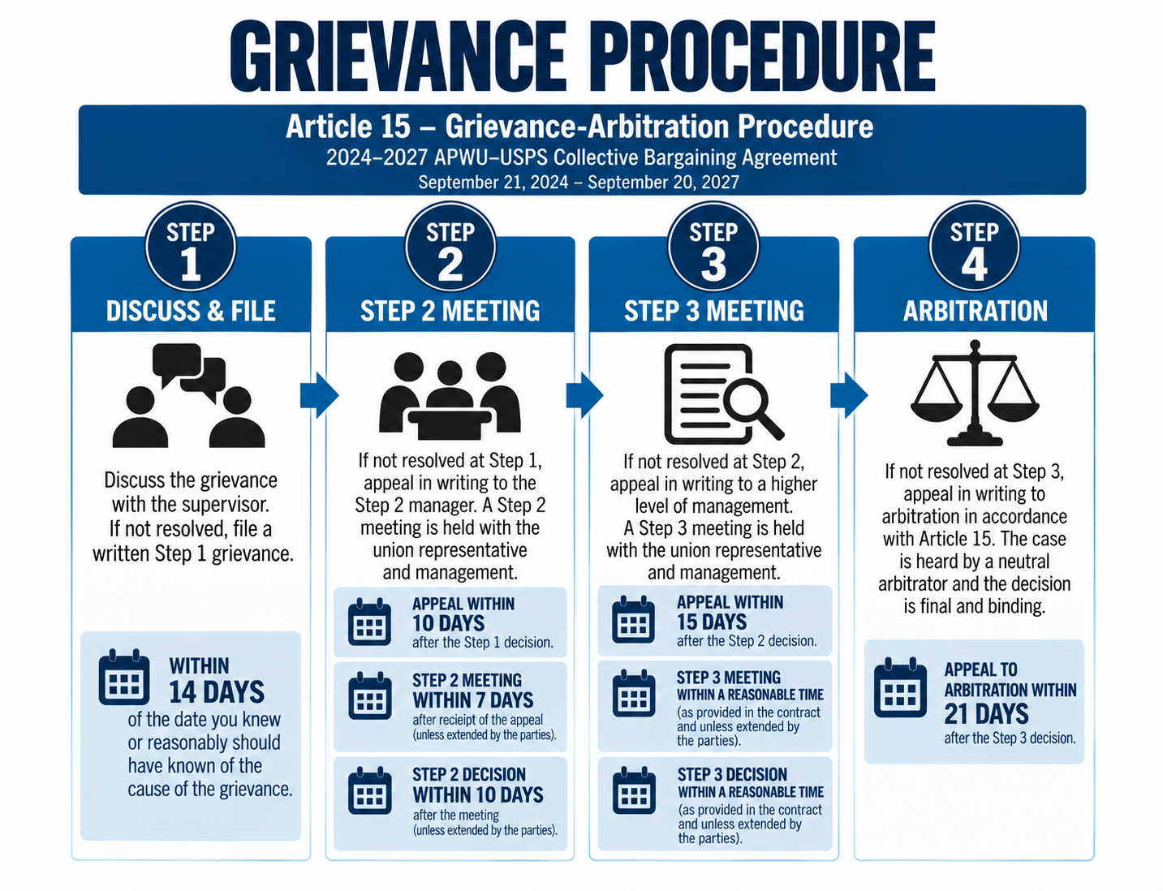
Grievance Timeline
Step 1 Meeting within 14 Days
Step 1 Answer within 5 Days
Step 2 Appeal within 10 Days
Step 2 Meeting within 7 Days
Step 2 Decision within 10 Days
Additions & Corrections within 10 Days
Step 3 / Arbitration Appeal within 15 Days

Slide 7
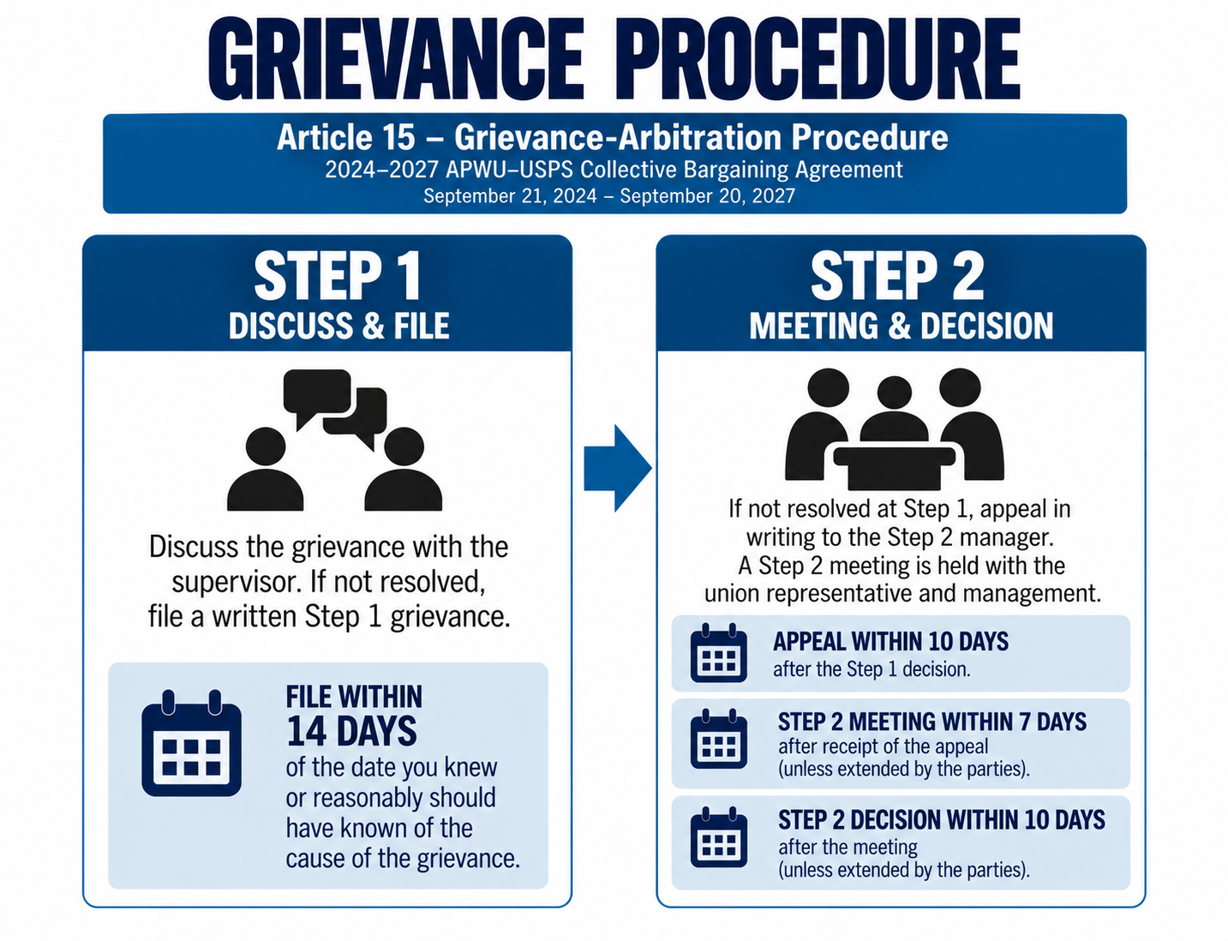
Your Role
You are either Certified to handle Step 1, or Step 1 & 2 Grievances for the 480 – 481 Area Local
As a Step 1 Certified Steward you must:
Prior to Step 1: Investigate, Document, & Prepare Grievance
Organize: Complete the 480-481 File Folder, Completely fill out File Maker (If Applicable), Complete Chronology Sheet (If Applicable), and Exhibit Sheet (If Applicable)
Meet at Step 1
Write Steward Notes on File or as a Statement

Slide 8
Your Role – Part 2
If you are a Step 1 Steward, after Step 1 you transfer the case to your assigned Officer for Step 2!
As a Step 2 Certified Steward you must do everything on the previous slide, plus:
Write Step 2 Appeal
Meet with Management at Step 2
Verify that Grievance is Organized, Documented, and Ready to Appeal
Transfer Case to Local after Management Verbal Answer

Slide 9
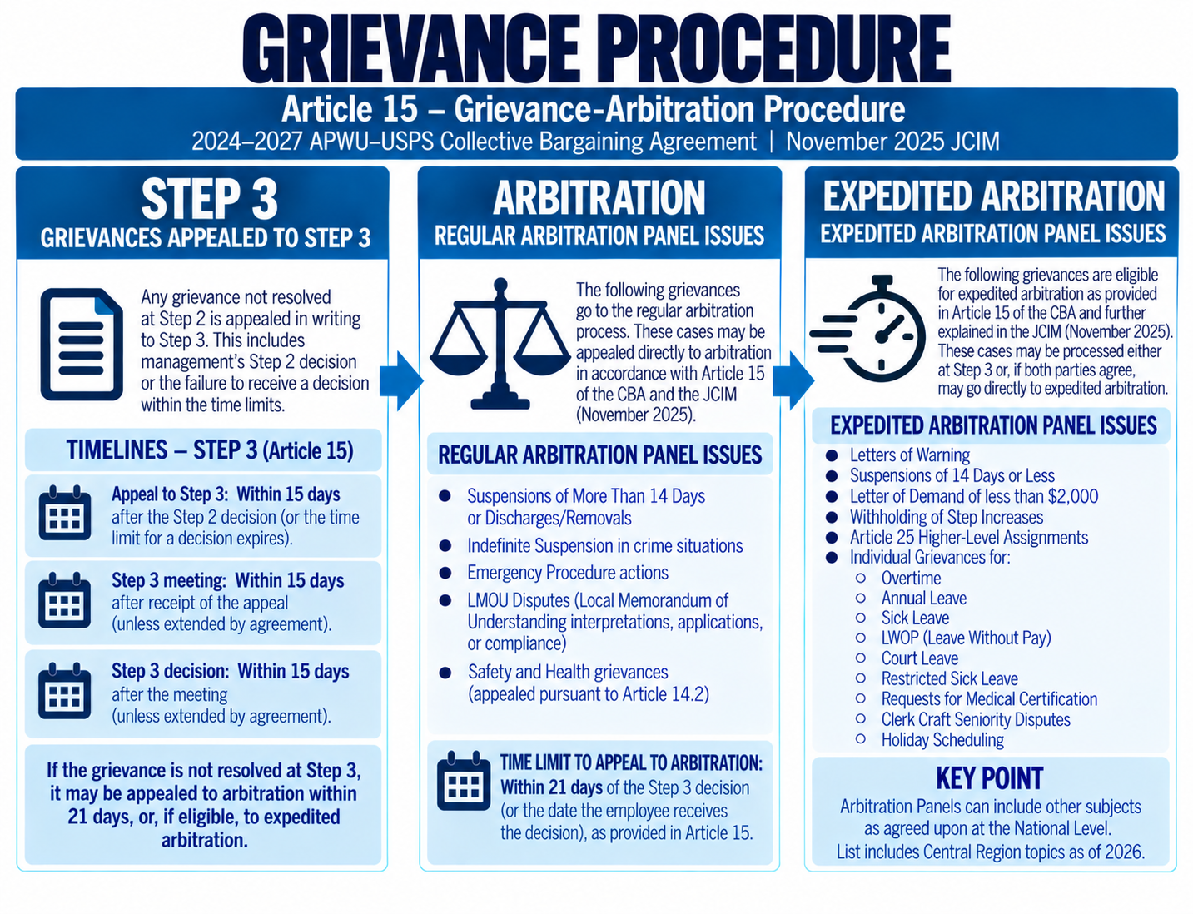
Officer / Arbitration Advocate Role
After a Step 2 Designee moves the case to the Local the Officer assigned will review the file, and either write or modify the Additions & Corrections (If Needed)
The Officer then will appeal the Grievance to the Appropriate Panel / Designee
A Step 3 Appeal includes a written appeal and a place for an updated remedy
An Arbitration Appeal has no room to write anything
Once at Step 3 or Arbitration, the parties meet on a first come, first serve, rotation basis for each panel

Slide 10

ACTIVITY # 1
Where does it go?
Emergency Placement
Harassment / Hostile Work Environment
Suspension of 7 Days
Denial of Information
Compliance & Enforcement
Letter of Demand for $1,000
Letter of Demand for $10,000

Slide 11
Big Picture
The entire process is designed for the previous Steward / Officer to prepare the Grievance and Casefile for the next person
Full disclosure is required at Step 2, meaning both parties must fully exchange all arguments and/or documents
When a Grievance is appealed to Arbitration, the parties are far more likely to settle in Pre – Arbitration if the casefile is organized and complete
Knowing where you case goes helps you better prepare your Grievance
No one knows what you investigated, saw, or found unless you write it down as an official document within the casefile

Slide 12
GRIEVANCE
investigation
SECTION 02
02

Slide 13

Is it a grievance?
The human memory is incomplete at best – before we file a Grievance we must verify everything we are told
Prior to filing a Grievance you need to have a general idea of the Article and Language Violated
If a member claims the Contract was violated and the facts disagree, notify your Officer / Chief Steward (Example: It is a violation to skip progression in Discipline. The member insists it was skipped, but you have proof it was not)
If you can’t find the Language / Article, it most likely is NOT a Grievance
This Photo by Unknown Author is licensed under CC BY-SA

Slide 14
How to Investigate
Part 1 – Preliminary investigation
Part 2 – Request for Information
Once a member asks for a Steward, pull them off the floor and hear them out
Explain to the member that you need a Statement immediately
Find the / any applicable language to determine if it is a Violation and speak to likely witnesses to answer, “Who, What, Where, When and How”
Explain to the member what you are doing and how the process works – “Once you finish your Statement I begin my investigation. As soon as I finish investigating, I will meet with your Supervisor and follow up regardless of the outcome.”
Once you have completed a Preliminary Investigation, you then pivot to your FIRST Request for Information
Use a Request for Information Templates (Such as made by Roscoe or G.U.T.S.) and the UnOfficial Grievance Guide on APWUSteward.com as a foundation / starting point
Add additional elements to your Request for Information to tailor it to what you know of your Grievance
Identify anyone you may want to Interview and add those in your RFI – including Date, Time, and Individuals Name
NOTE: If a non-member asks a question, we must file a Grievance if it is a Grievance. But we ALWAYS ask them to join BEFORE representing them: “I see you are a non-member, if interested is the official form to sign up.”

Slide 15
ACTIVITY # 2
Sample RFI
Each of you will be provided multiple blank Requests for Information (RFI) Sheets
On the following slides, you will be presented a fake scenario based on real phone calls to the Local and real Steward Requests
Everyone in this room is experienced enough, and skilled enough to write the RFI – the purpose is practice, not perfection!
We want you to spend 10 minutes on each RFI, and we will spend ten minutes as a group discussing what found

Slide 16
ACTIVITY # 2
ACTIVITY # 2 A
ACTIVITY # 2 B
A member called and told you that they were not allowed to work the Labor Day Holiday or their NS Day. They said they were from a Local Post Office represented by the 480-481 Area Local. The member was asked if anyone else worked the Holiday and the member said, “I think Susan Oppenheimer did.” You asked if Management solicited for the Holiday, and the member said, “What is that?”
A member comes up to you on the workroom floor and told you that they received ‘this in the mail about a week ago’. It is a Notice of Removal for Attendance. The Notice of Removal is dated nine days ago. On the Notice of Removal you see the Steward in the Investigative Interview was Eric Chornoby. You speak to Eric and receive his notes. You discover that in the Interview the many 3971’s covered multiple days, but on the Discipline Management listed each absence individually.

Slide 17
How to Investigate Part 2
Part 3 – Complete Investigation
Part 4 – Build Grievance filE
Craft any / all potential Interviews you need to Conduct – this may take a while!
Refer to UnOfficial Grievance Guide for Interview Ideas
Conduct any interview(es) you deemed necessary in Part 2 – Request for Information
Review the first Request for Information if / when received to determine if you received all you requested
Submit a Second Request for Information if necessary
Document all Documents received from the Request for Information (either in a Statement, in an Exhibits Receive Sheet, or another form of documentation)
Place all Documents in Order (Based on the Order of Document Sheet, Officer Recommendation or UnOfficial Grievance Guide)
Complete any Organizational Documents you have (Chronology, Exhibit List, File Folder, File Maker, etc)
Review & Prepare to Meet at Step 1

Slide 18
ACTIVITY # 3 interviews
Interviews have many purposes. They can be used to Prove a Violation, Codify or Confirm the Record / Information, Establish Negative / Adverse Inference, and so much more!
If you have a ‘hole’ in your Grievance, or lack a smoking gun, an interview is a good idea
I want each person to find a partner and individually spend 15 minutes writing an interview based on the following prompt, and then spend 10 minutes (Total) interviewing your Partner
Each person will select ONE prompt

Slide 19
ACTIVITY # 3
ACTIVITY # 3 A
ACTIVITY # 3 B
You are investigating a potential Grievance for a member who was not allowed to work the Labor Day Holiday. You have the LMOU, Seniority List, OTDL, Vacation Calendar, Clock Rings showing a junior employee Susan Oppenheimer worked on the Holiday and the members Statement. Management did not provide you the Holiday Solicitation List. The LMOU requires Management solicit Holiday volunteers, and the Manager is responsible for this solicitation. Identify who you would interview, why you would interview them, and then write at least 5 mock interview questions.
You are investigating a Notice of Removal. You are still waiting on the Request for Information to be completed, but you have the both sets of Interview Notes, date/time/subject of a Documented Discussion, the 3971s, the 3972, a copy of Managements Request for Administrative Action, a copy of the Discipline, Documentation of Attendance Reviews, No Medical Documentation and the members Statement. In the Statement the member claimed they submitted Medical Documentation to Management, and to quote, “I turned in my Doctor note to Supervisor Browning every time I missed work.” Identify who you would interview, why you would interview them, and write at least 5 mock interview questions.

Slide 20
Activity # 3 – Reflection
When investigating some Grievances you will quickly discover you need a key piece of information that only one person has – which makes an Interview the obvious choice
In other Grievances you will find a lot of murky water and must decide if you should interview as it may harm your Grievance and if so, who is the best person to interview
You should only conduct an interview if you believe you can get the answer you need from the interviewee
While some training recommends interviews for all Grievances, we only recommend them as needed. Interviews take a considerable amount of time, energy and effort and are unpredictable
A good interview is an excellent way to get more Steward time, to put pressure on Management, and confirm a violation which results in winning your Grievance!

Slide 21
Step 1 Meetings
SECTION 03
03

Slide 22

Preparing for a Negotiation
By time you need to meet at Step 1, your entire Grievance should be prepared, documented, and reviewed
Your Casefile should be prepared and ready to Appeal to Step 2
You should have a copy of the CBA, JCIM and Casefile with you when you enter the Step 1 Negotiation
You do NOT exchange documents with Management UNLESS it will resolve the Grievance at Step 1!
This Photo by Unknown Author is licensed under CC BY-SA

Slide 23
Negotiation framework
One of the biggest hurdles to meeting at Step 1 is not knowing what to say – despite this being a known issue, no one in the APWU has a training for it and we expect a Steward to ‘wing-it’
The only time you ever ‘wing-it’ is when you do not have time to build a Grievance due to a member notifying you untimely (For example, receiving a copy of Discipline on Day 14 – you immediately meet with Management!)
You must know your Casefile front to back before you ever meet with Management
You should not spend a lot of time going back and forth unless it will help you resolve the Grievance
From several legal classes / courses I have identified the two best repeatable frameworks for Negotiating at Step 1 that we are going to learn together – I.R.A.C. & Logical Arguments

Slide 24
I.R.A.C.
I.R.A.C. stands for Issue, Rule, Application/Analysis, Conclusion
Issue is what happened – “On September 19th Jane Doe was issued a Letter of Warning” or “Employee Jane Doe was not offered an opportunity to work the Labor Day Holiday”
Rule is the violated Language / Article – “Article 16 states that for minor offenses Management is required to have an Article 16.2 or Documented Discussion with the employee” or “The LMOU states that employees will be solicited for the Holiday and employees will be scheduled by seniority”
Application/Analysis is how the Rule applies – “Jane Doe never had a discussion as confirmed by the Unions RFI” or “No solicitation occurred”
Conclusion is your remedy and potential summary – Since Article 16 was violated, the Union is requesting the Letter of Warning to be reduced to a Discussion” or “Due to the LMOU violation the Union is requesting Jane Doe be compensated for hours she was not permitted to work”

Slide 25
I.R.A.C. at Step 1
You approach Management, tell them you need to meet at Step 1, and thank them for meeting with you
Then, present your case:
“(I) On September 19th Jane Doe was issued a Letter of Warning. (R)Article 16 states that for minor offenses Management is required to have an Article 16.2 or Documented Discussion with the employee. (A)Jane Doe never had a discussion as confirmed by the Unions RFI. (C)Since Article 16 was violated, the Union is requesting the Letter of Warning to be reduced to a Discussion.”
“(I)Employee Jane Doe was not offered an opportunity to work the Labor Day Holiday. (R)The LMOU states that employees will be solicited for the Holiday and employees will be scheduled by seniority. (A)No solicitation occurred. (C)Due to the LMOU violation the Union is requesting Jane Doe be compensated for hours she was not permitted to work.”
It is that simple. You can then negotiate to come to an agreement or allow Management to deny what you are requesting!

Slide 26
ACTIVITY # 4
I.R.A.C.
Using the previously identified prompts, I want you to create a your own I.R.A.C. styled Step 1
Your I.R.A.C. should be your easiest violation to prove
This should be short, in and out
Spend ten minutes creating an I.R.A.C. for both examples on the next slide

Slide 27
ACTIVITY # 4
ACTIVITY # 4 A
ACTIVITY # 4 B
You investigated a Grievance and discovered that Management did not conduct Holiday Solicitation for Labor Day, and they allowed a Junior employee to work. This is in direct violation of the LMOU and Article 30 – which creates the LMOU, as well as the Principles of Seniority. Create an I.R.A.C. you would use to present your case at Step 1.
An employee received a Notice of Removal and you only had five days to work on it as they notified you late. Today is day 5, and you need to meet with Management. What you know for sure is Management never had a discussion with the Grievant, nor did they provide you Medical Documentation in your Request for Information the employee claims they submitted. Create an I.R.A.C. you would use to present your case at Step 1.

Slide 28

Logical Arguments at Step 1
The next framework is for those who like to play the common-sense game with Management
The Logical Structure is about presenting ‘truths’ to Management so they will be forced to agree with your conclusion – just like a Debate
A Logical Argument has three parts – Universal Fact, Issue or Situation Specific Fact, and the Common Sense Conclusion
Universal Fact: A Statement that is Always True
Situation Specific Fact: A fact that is only accurate in the given situation
Conclusion: The Logical Conclusion of both Facts being true

Slide 29

Logical Argument example
Universal Statement: Roses are Red, and Violets are Blue
Situation Specific Statement: This flower is not Red or Blue
Conclusion: Therefore, this flower is not a Rose or a Violet
You tell Management: Roses are Red, and Violets are Blue. This flower is not Red or Blue. Therefore, this flower is not a Rose or a Violet
This Photo by Unknown Author is licensed under CC BY

Slide 30
ACTIVITY # 5
Logical Argument
On the next slide you will be presented a sample Logical Argument as well as a prompt to create your own
I want you to spend five minutes creating your own Logical Argument
Again, this is not a right or wrong answer situation – practice makes perfect!

Slide 31
ACTIVITY # 5
Sample & Logical Argument
Example
ACTIVITY # 5 A
Universal Truth / Something that is always True: Article 16 States, “The principle that any discipline must be for ‘just cause’ establishes a standard that must apply to any discipline or discharge of an employee”
Issue Specific Fact that is True in this Situation: The Grievant was not aware of the Rule being applied as confirmed during the Investigative Interview
Conclusion: Therefor, this Discipline does not meet the Requirements of Article 16
What you say: “Article 16 States, ‘The principle that any discipline must be for ‘just cause’ establishes a standard that must apply to any discipline or discharge of an employee.’ The Grievant was not aware of the Rule being applied as confirmed during the Investigative Interview. Therefor, this Discipline does not meet the Requirements of Article 16 and must be expunged.”
A member told you they saw Management performing Clerk Work when they sorted mail while the Clerks were on lunch. You have verified through witness Statements, package scans, and interviews that it is true. A Supervisor, Billy Simmons, sorted mail for an entire 30 minutes. Identify the Universal Truth / Rule, Identify the issue specific Rule that is True in this Situation, and form a Conclusion.
HINT #1: The Universal Truth will always be clear Contractual / ELM / JCIM Language
HINT #2: The Issue Specific Fact is always a fact you have proven during your Investigation
HINT #3: The Conclusion is the Logical Conclusion you want Management to reach and your requested remedy

Slide 32
Step 2 Appeals
SECTION 04
04

Slide 33
Step 2 Appeal Language
Article 15.2 Step 1(d): The Union shall be entitled to appeal an adverse decision to Step 2 of the grievance procedure within ten (10) days after receipt of the supervisor’s decision. Such appeal shall be made by completing a standard grievance form developed by agreement of the parties, which shall include appropriate space for at least the following:
1. detailed statement of facts;
2. contentions of the grievant;
3. particular contractual provisions involved; and
4. remedy sought.
Article 15.2 Step 2(a): The standard grievance form appealing to Step 2 shall be filed with the installation head or designee. In any associate post office of twenty (20) or less employees, the employer shall designate an official outside of the installation as the Step 2 official, and shall so notify the Union Step 1 representative.
JCIM Article 15.2 Step 2(c): The Union representative at the Step 2 meeting shall fully discuss the Union’s position, including the contractual provisions allegedly violated and the corrective action requested…Both parties are required to state in detail the evidence and contract provisions relied upon to support their positions. The Postal Service is also required to furnish to the Union, if requested, any documents or statements of witnesses as provided for in Article 31, Section 3.

Slide 34
Language Explained
Article 15.2 Step 1(d) means: If the Union is appealing a Grievance to Step 2 they must use the mutually agreed upon form. The form must include: Detailed Statements of Facts, Contentions or Arguments of the Grievant / Union, all Contractual Provisions Involved, and the requested Remedy. If the form includes it, it is Mandatory to fully complete.
Article 15.2 Step 2(a) means: The Step 2 appeal must be sent to Managements designee. The Union does not pick who that designee is, and failure to submit the appeal properly can be a waiver of the Grievance or Timeliness.
JCIM Article 15.2 Step 2(c) means: At Step 2 the Union must present its entire case, including the Contractual Provisions involved, the corrective action requested, and the Union must explain its position / side of the story. Both parties are required to fully list and explain their evidence, the contractual provisions involved, and how they are involved.

Slide 35
Why this matters
Just as the Unions wins Grievance based on procedural and technical arguments, Management does as well
Failing to complete any required section allows for a Legal Doctrine called “Opening the Door”
Opening the door allows the other party to introduce new argument and evidence because the opposing party brought the topic up first
Example: Management is allowed to claim the Union is untimely at Step 1 or 2 because the Union did not fill that portion of the standard form out
Failing to meet with the correct designee (At any level) means the Union did not properly meet or appeal the Grievance
Example: If you email Step 2s to a Secretary normally, and send it to a Manager instead, the Step 2 was not properly submitted
The Union must, on the Step 2 and verbally, fully present its case including evidence used, how the evidence applies, contractual provisions, how the contractual provisions apply, and so on. A failure to do so renders any additional evidence in the casefile or presented as new evidence and can be inadmissible

Slide 36
A Simple Step 2
Every Steward has their own way of writing Step 2s
No one cares how you write a Step 2, as long as it includes all the basic, required information
Step 2 styles include: Overtly legal (Writing to the Arbitrator), Telling a story (A narrative of what occurred), CBA language only (Citing multiple CBA provisions followed by an explanation of what Management did), Kitchen Sink (Any possible argument crammed together), etc
No matter how a Step 2 is written, they all ‘work’ if the required information is included
After helping multiple Locals, States and hundreds of individuals write Step 2s, I (Eric) identified that most people adapt a style but commonly miss the same things. E.g. The Telling a Story style does not normally connect the dots to evidence or the Contract. To prevent this, a simpler 4 step structure has been created!

Slide 37
5 Core Elements
The Completed Form – You must first fully complete the mutually agreed upon form. On a Step 2 this is the top section which has the Step 1 information, the Grievant's information, etc.
Paragraph 1: Required Grievance Information – Explain why the parties are meeting, and include any basic information such as extensions.
Paragraph 2: Narrative / Relevant Background – Lay the foundation of the Grievance. You write your own brief Narrative, explain the context, or list relevant background information that pertains to your Grievance.
Paragraph 3: Your Arguments / How the Contract was Violated – This is where you cite the Contract, explain violations, and explain your evidence.
Paragraph 4: The Harm / Your Remedy – This is where you list your remedy and explain why it would remedy the violation.

Slide 38
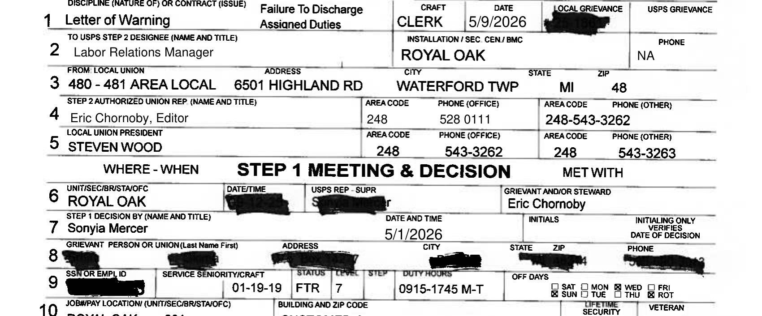
Element 1: Completed form
If any information is missing here is opens the door for Management’s Challenge!

Slide 39
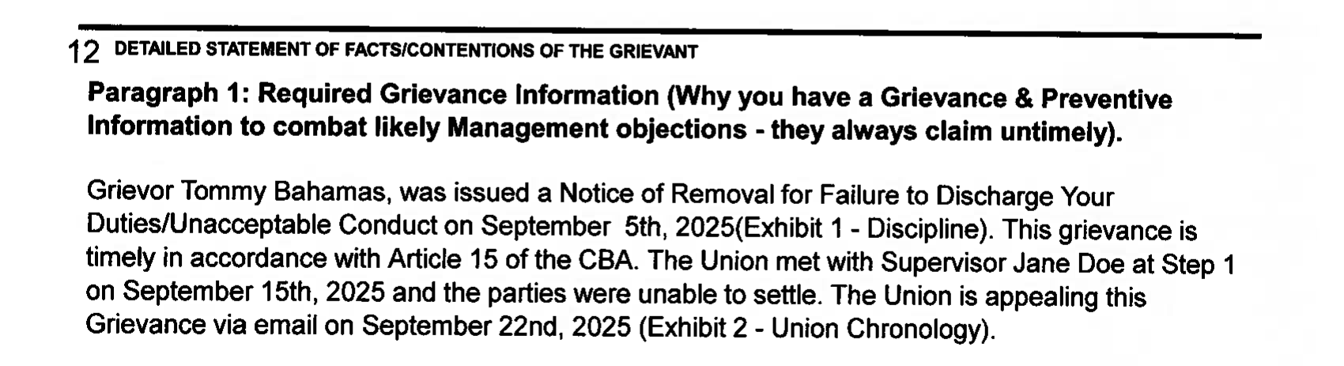
Paragraph 1: Required Grievance Information
This first Paragraph simply covers the basic information of the Case. Who is involved, what the core accusation is, and you include basic information that does not fit elsewhere.

Slide 40
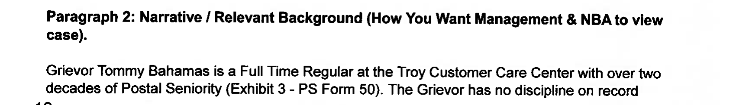
Paragraph 2: Narrative / Background
The second Paragraph includes the Unions side of the story, and relevant information. For discipline, this includes mitigation such as length of service. For a Class Action such as Harassment, you would explain what happened, list witnesses, etc.

Slide 41
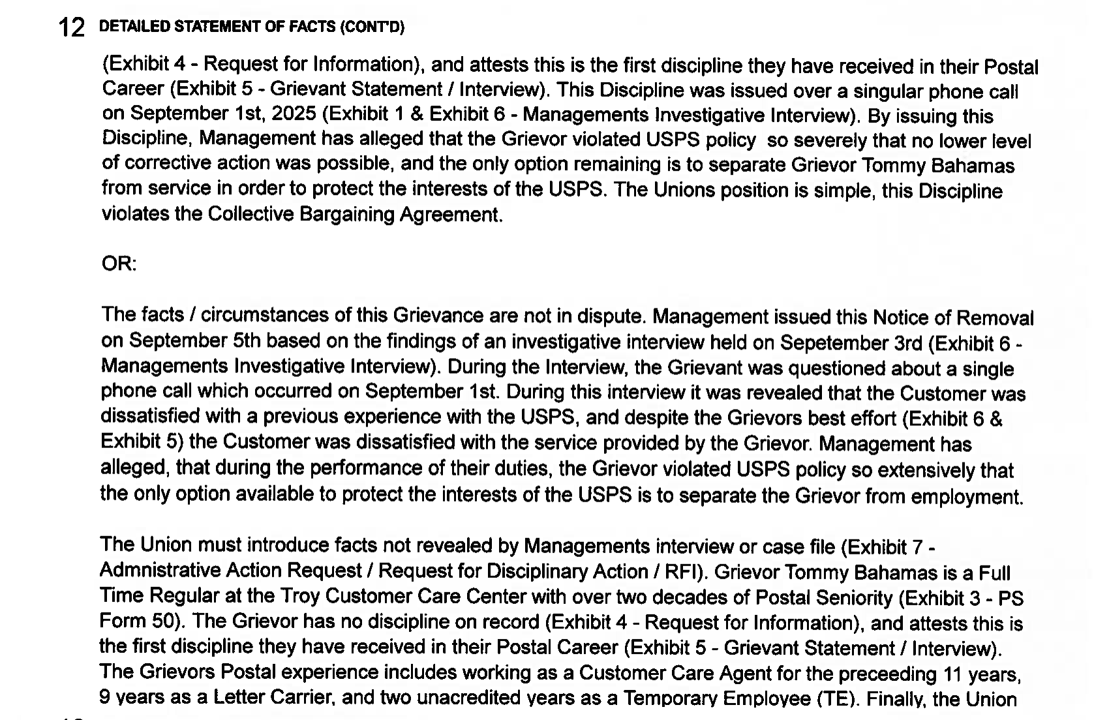
Paragraph 2: Part 2
Each section is as long as needed
The example packet includes two different formats of the same appeal
The point is to illustrate what information can be included

Slide 42
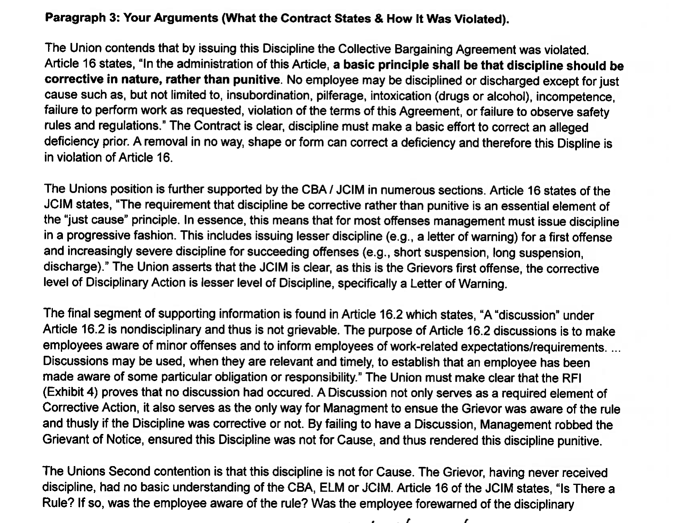
Paragraph 3: Your Arguments / cba violations
This is the ‘meat and potatoes’ section of your Grievance
Each and every violation should be included within this section
An easier way to approach this section is to view it as, “How the Contract says Management is wrong”
You should quote language, cite the Contract, and list exhibits in this section

Slide 43
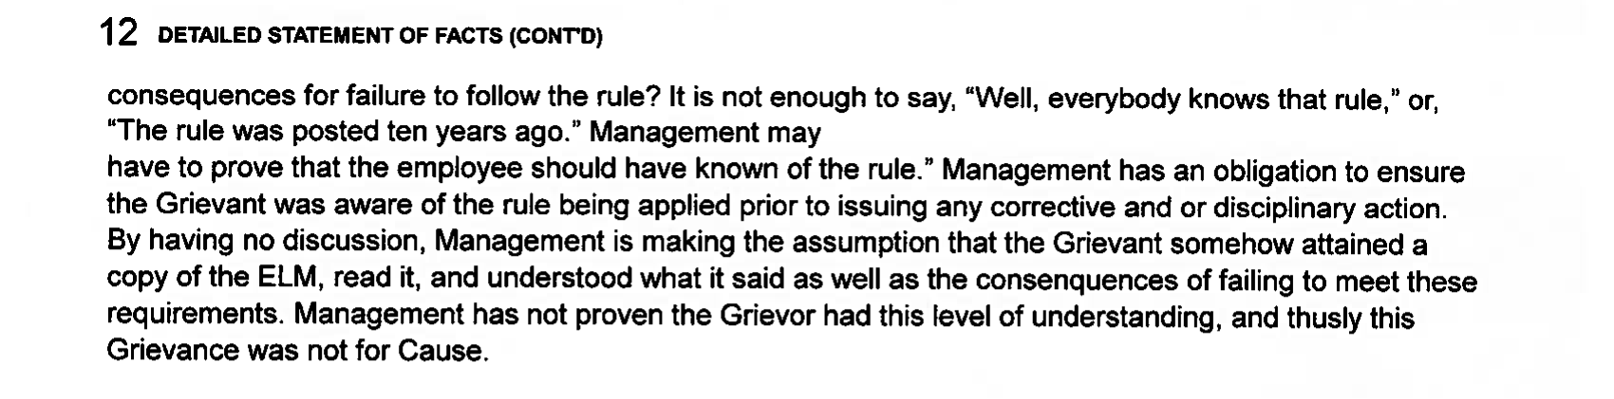

Paragraph 3: Part 2
Paragraph 3 always wraps up with either the Grievant being innocent, or, with Management being guilty. The entirety of Paragraph 3 is you proving one of these points.

Slide 44
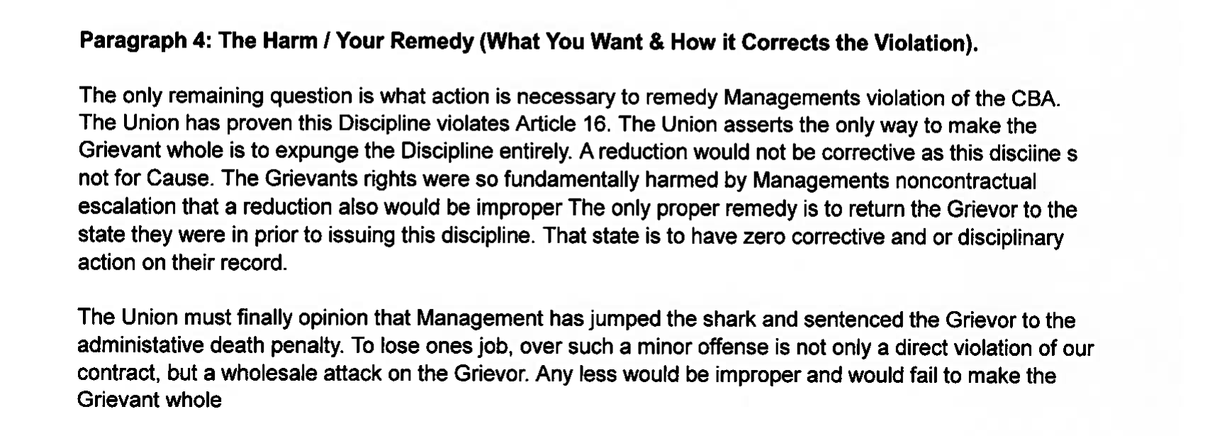
Paragraph 4: The Harm / Your Remedy
This is where you argue the remedy. Your remedy should do two things: One - Return the status quo to how it was before Management violated the Contract; Two – Make the Grievant whole.

Slide 45
Practice Makes Perfect
SECTION 05
05

Slide 46

Building Blocks
This whole training has been designed to bring everyone up to the same standard and ensure everyone has an advanced grasp of the issues we deal with daily
Everyone in this room has strengths and weaknesses – you may only get one thing out of this training, but that one thing will help you be a better Steward
We went over mechanics – how we do things
We did NOT go over reading the Contract, Understanding the contract, or using the Contract
Our final exercise will be an activity that will force you to use and understand the Contract!

Slide 47
The Final Exercise
Why end on this note?
The Final Exercise
Before we dive into the final exercise, we need to identify what the purpose of this exercise is
As a Steward you will get approached on the floor every day by members, non-members and Supervision with the expectation you can answer at the drop of a hat
You will get asked questions that are not Grievances, and you will get asked questions that may be a Grievance, but you must find the language
Every member deserves a correct answer, no matter how confusing their question is!
Across all of the offices we represent, we see trends of members not receiving the correct answer and Grievances lacking the correct Article(s) cited
For this final exercise you are putting yourself into the shoes of a shop Steward or a Step 1 designated Steward
Each person will be given a prompt or scenario
Your job is to handle the scenario up to transferring the Case to a Step 2 Designee or turning it into the Local
If it is not a Grievance, you must still deal with the member, find the related language, and submit an information request
If it is a Grievance you must deal with the member, submit your RFI, and prepare and hold your verbal Step 1 including your Strongest argument as covered in this training, and attempt to settle

Slide 48
Self Imposed Roadblocks
As a Steward you will develop habits designed to either make your life easier, or because you were never shown a different way to handle a situation
For example, I have the habit or ‘over-documenting’ my Grievances – this habit was born from the parties at Step 3 not reading the full casefile or not understanding the arguments raised
Not all habits are bad! What we don’t want is any habit to harm you or the Grievant
Again, if you currently have one of these habits, that does not mean you did or are doing anything wrong up to today – even your Officers are guilty of these at times, and we only learned because someone told us! (But if you keep doing these things, that is a different story!)
The next two slides will cover common issues we see in turned in or appealed that must be avoided and will not be accepted in this exercise

Slide 49
Common issues – The Big 3
The 480 – 481 Area Local & our NBAs have seen a trend of case files missing essential elements – and I am willing to bet no one EVER told you WHY they were important!
MISSING INFORMATION
Basic Required Documentation: Clock Rings, Form 50, Statements, 3971’s, 1260’s, Interviews, Request for Information (RFI), etc
Organization: Grievance Chronology Sheet, 480-481 File Folder, Exhibit List, File Maker (If Applicable), or an explanation of the casefile
Articles Violated: Specific Article (Including a quotation, citation, or section) in CBA / JCIM, ELM Language, etc
WHY IT MATTERS
This information is needed to prove Management violated the Contract – Without all basic required documentation you can't prove a violation
Both parties must assume excluded information did not happen & if the file is not organized essential information may be missed. If your case if confusing, and you don’t have a statement, the Grievance may be closed!
If specific language is not cited, it is not a Grievance. We must rely on luck to raise new argument in Arbitration

Slide 50
Habits to avoid: Procedural death sentence
Extensions | Extensions are intended for emergencies. Justice Delayed is Justice Denied. We also can risk non-pecuniary remedies by delaying the process. Example: Metroplex Award GATS # 23315590: Back Pay for EP due to Management delaying. Also, where in the Contract are extensions granted at Step 1?
Not Using Managements Designee | In all facilities, Management has the right to pick a ‘designee’. If you meet with the wrong person, or appeal to a non-designee, the APWU is the party that failed to meet
Using AI to Write | Yes, we can tell. So can an Arbitrator, and we know when Management uses it. According to the IBA (International Bar Association) AI is known to ‘hallucinate’ information and is strongly discouraged from use. The issue is AI requires you to upload ALL relevant documents and exclude incorrect – if not you get the wrong answer! (If you want examples, ASK!)
Improper Remedy | Your Remedy must be proportional to the violation and evidence – if you want money for emotional distress, you need a Contractual Violation and to prove the emotional harm via Doctors Notes, EAP, etc

Slide 51
Exercise Hints
Eric has prepared over 20 unique scenarios for this exercise
The exercise contains general and craft specific scenarios – an Officer will hand you a scenario to ensure you have your craft!
Each scenario is designed for you to prepare a Grievance up to Step 1 without any additional information – you still need to submit the RFI to prove the facts you have!
If a key piece of information is excluded, it is INTENTIONAL and important to your Grievance
Just like a real Grievance going to Arbitration, you only want your Strongest arguments – but some scenarios may only have a weak argument!
The vast majority of scenarios have a single main Contractual violation, if two are equal it will be noted for you

Slide 52
The Activity
You are preparing the Grievance to be turned into a Step 2 Designee / Officer which means every step before hand that is required must be completed
You are expected to explain to the Grievant if the complaint is a Grievance or Not based on Contractual Language you find
If your scenario is from a non-member, you must ask them to join the Union – you will be told!
If the Grievance may need any information from Management, you must write out a Request for Information
If you must meet at Step 1, you must prepare your Step 1 Argument
Today we have covered writing an RFI and forming Arguments at Step 1. We have not covered:
Asking a member to join, for that we will have John give an example of what he tells members in Orientation to get them to join!
As experienced Stewards everyone should know how to use the CBA and JCIM, but if you struggle to find something, ask one of the Officers during the exercise!

Slide 53
Example
Read the prompt: “Susan was issued a Noice of Removal ‘a few days ago’. You remember having an Interview with Susan 4 months ago and at that time she signed up for the Union. You ask to see the Discipline, and you see Management quoted the Investigative Interview as the meeting you had 4 months ago, and the discipline is dated this week.”
Determine if the Grievant is a member, and if not determine how to ask them to join: NA
Determine if the Contract was violated: Yes
Determine what to tell the Grievant: “I am filing a Grievance for you and will follow up with you by the end of the week once I meet with Management. At this point you must continue to work despite what the letter says until I let you know what the outcome is.”
Determine what the specific provision violated is: Article 16 JCIM – “Was the Disciplinary Action Taken in a Timely Manner? Disciplinary actions should be taken as promptly as possible after the offense has been committed.”
Write a sample RFI: 1. Copy of Discipline, 2. Copy of Investigative Interview, 3. Interview Issuing Supervisor, etc.
Write your Step 1 Argument: Article 16 of the JCIM states, “Disciplinary actions should be taken as promptly as possible after the offense has been committed.” Management investigated this matter four months ago. Therefore, this Discipline violates the Collective Bargaining Agreement and must be expunged.”

Slide 54
FINAL ACTIVITY
Mock Grievance
On your own, spend the next 60 minutes completing the following steps:
Determine if the scenario is a Grievance
If a non-member, ask them to join
Explain to the member if it is a Grievance
Create a Request for Information if needed
Prepare your Step 1 Argument if needed
If you have questions or finish, raise your hand or ask an Officer to verify what you found
REMEMBER TO TAKE YOUR TIME!

Slide 55

Wrap up
You now have the skillset to find a violation, explain to a member if it is a violation, to write an RFI, to write an interview, and to prepare a Step 1 argument
To retain what we covered, you need to use it!
I would like to thank the John, Roscoe and Eric for instructing, and the Executive Board for assisting in our final exercise
What questions do you have?

